Slide 1


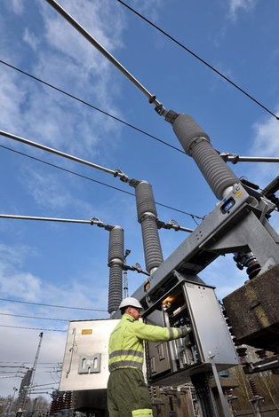
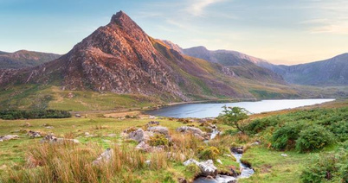

SP Energy Networks
Barmouth
1

Slide 2

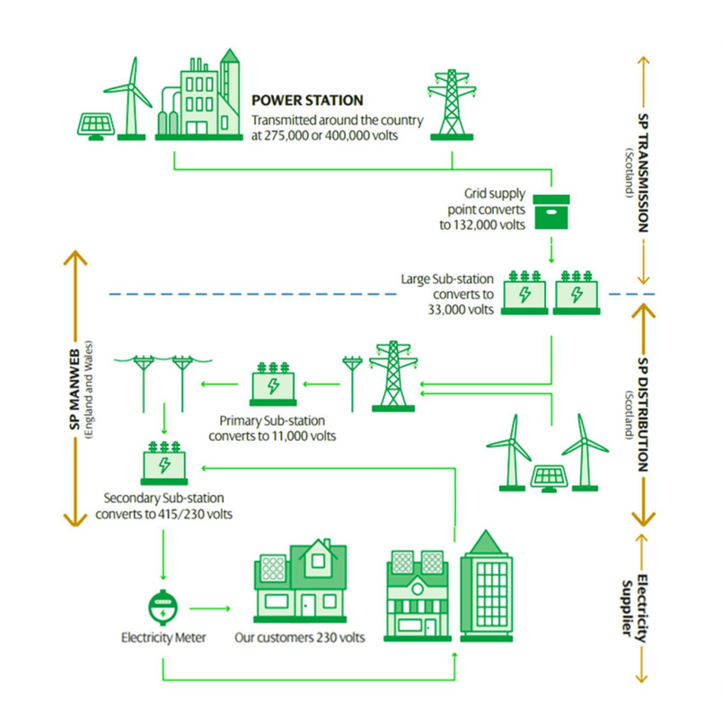
What is our role?
Our role as a Distribution Network Operator (DNO) is to keep electricity flowing to the homes, schools, hospitals and businesses in your community.
We own and maintain the cables, substations and infrastructure that make up the electricity network.
As the way we use electricity chages, we also need to invest in and strenghten the network to make sure it has the capacity, reliability and resilience communities will need in the future.
For Barmouth, that means investing in the exisiting network now to ensure it can continue to meet growing electricity demand for years to come.
2

Slide 3
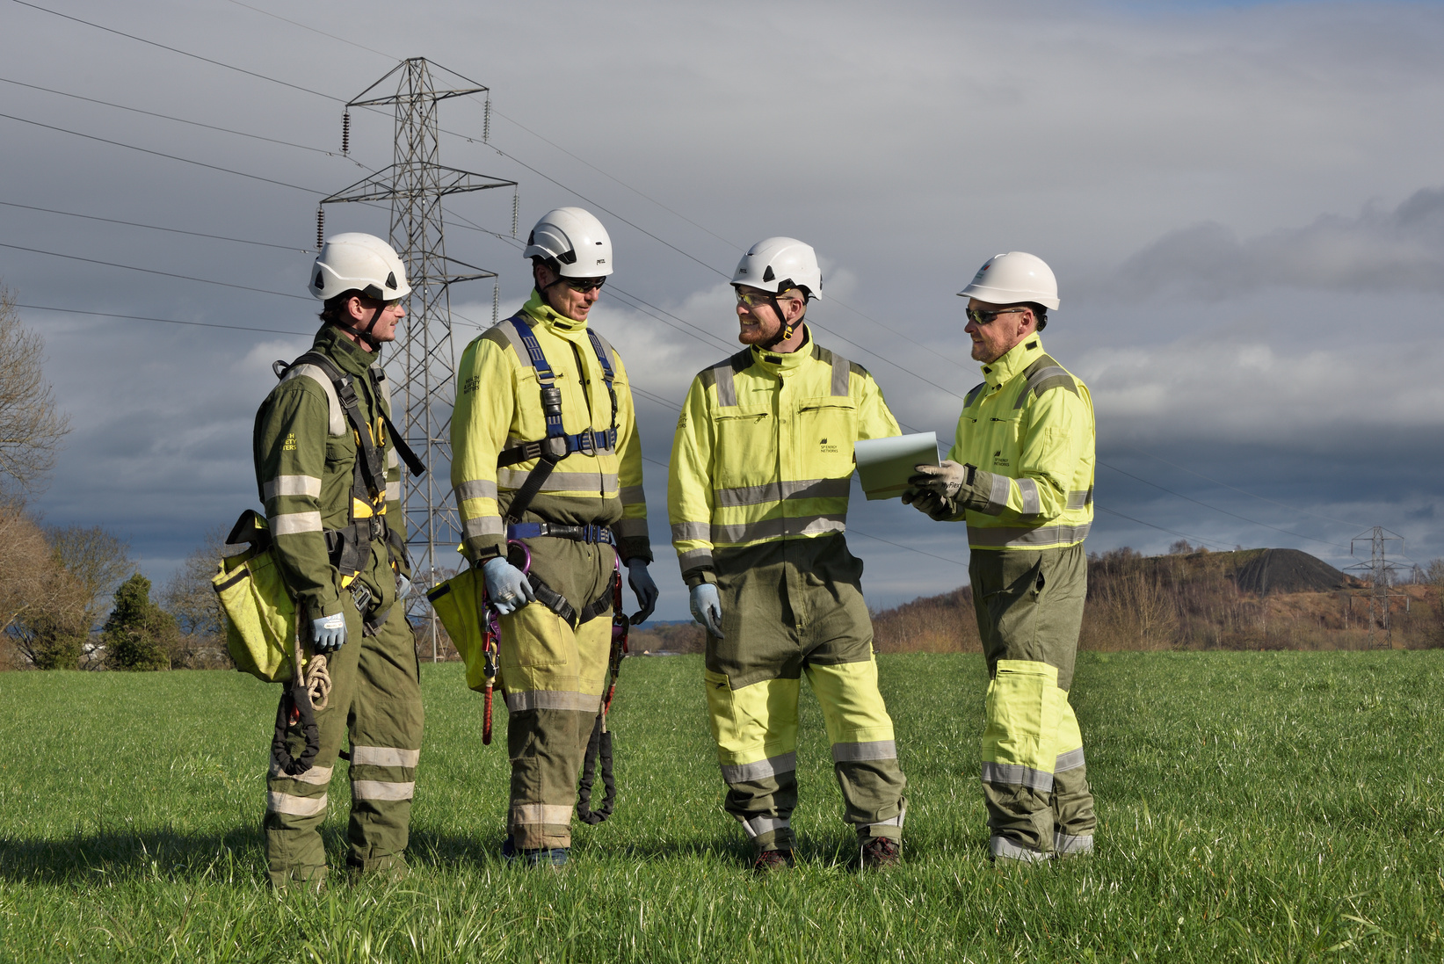
Why we’re here
Barmouth's electricity network needs upgrading to meet the town's future needs.
Much of the existing electricity network in Barmouth dates back to the 1950s and 1960s. We are investing £1.5 million to reinforce the underground cable network in the town centre.
The project will:
  Upgrade ageing infrastructure so the network has capacity to meet future electricity needs
  Improve reliability and resilience for homes and businesses across the area
  Prevent the network overloading, as estimated to happen in 2028
£1.5mil investment into Barmouth’s electricity network
3

Slide 4
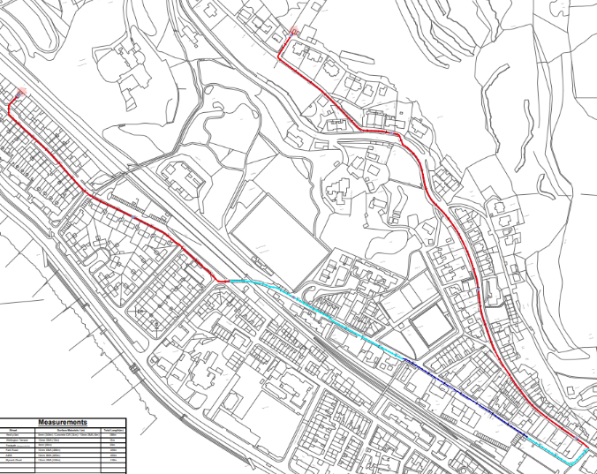
What needs to be done
We need to install new underground electricity cables through Barmouth town centre to reinforce the network.
The process:
1.
Duct installation
The main construction phase, involving excavation works to install underground ducts (protective pipes) for the new cables to run through.
Cable installation
Once the ducts are in place, the new cables are pulled through and connected at specialist access points known as joint bays.
Reinstatement
Once each section of work is complete, roads, footpaths and surrounding areas are returned to their orginal condition
2.
3.
The work will progress in sections along the route, allowing us to complete and reinstate areas as the project moves forward.
4

Slide 5
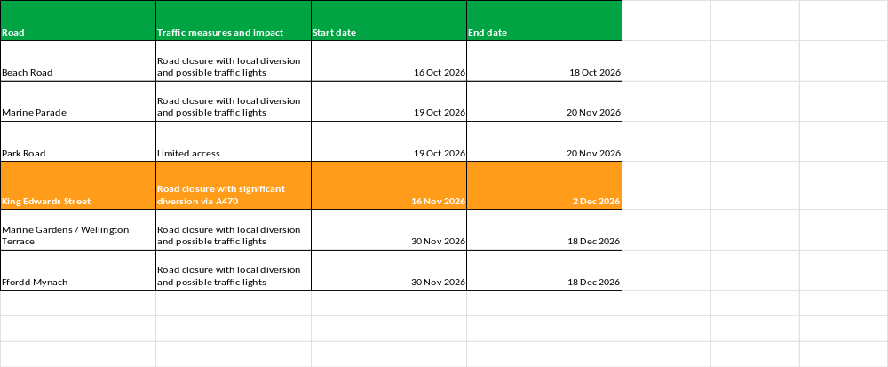
Indicative dates
5

Slide 6
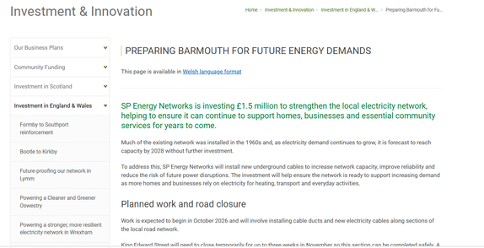

Impact to communities
Our project web page
We recognise that work of this scale will cause disruption, particularly for people travelling through Barmouth town centre.
Traffic management
Temporary traffic management will be required as we progress along the route, including temporary traffic lights in some locations.
King Edward Street closure
The main phase of work will require King Edward Street to close between The Royal pub and St Tudwal's Church for up to three weeks between 16th Nov - 2nd Dec.
Keeping disruption to a minimum
  Make traffic management measures and restrictions as short and predictable as possible.
  Specifically designed to avoid disrupting tourist season and festive events.
  Work in short sections so each area is affected for the minimum time.
  Maintain access for residents, businesses and emergency services wherever possible.
Scan here to visit our website or go to:
https://www.spenergynetworks.co.uk/Barmouth_reinforcement
6

Slide 7
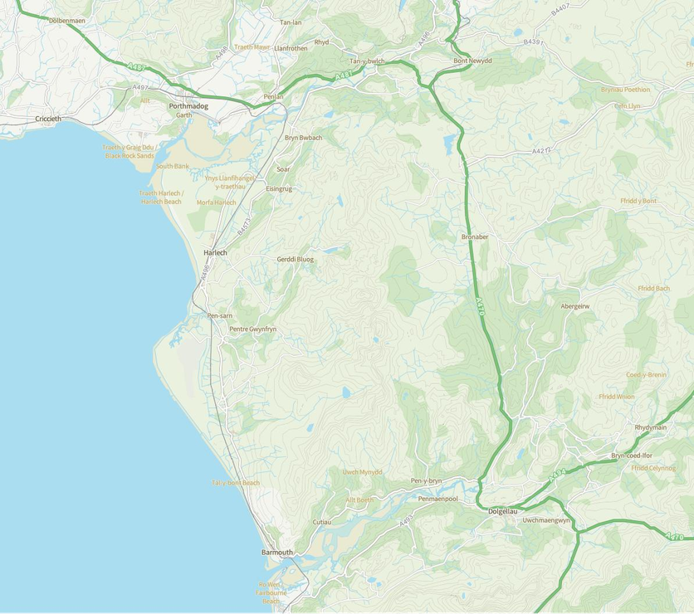


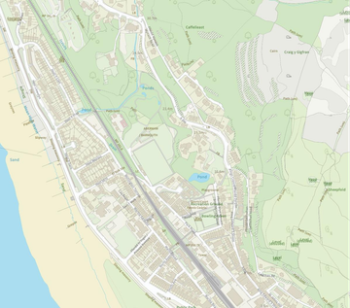
King Edwards Street
FFORDD O'CH BLAEN ROAD AR GAU AHEAD ROAD CLOSED AHEAD CLOSED
ROAD
FFORDD
AHEAD
YMLAEN
CLOSED
DIVERSION ROUTE
MYNEDIAD
ACCESS
GAUO YNNLY UNIG
ROAD
Road closure (16th Nov - 2nd Dec)
DIVERSION
A470 - A487ANDVISEVERSA
HGV'S FOLLOW DIVERSION
AHEAD
CLOSED ACCESS ONLY GWYRIAD DIVERSION
Traffic Y
Diverted
DIWEDD Y
DGIWVEYRRSIAIODN
DIVERSIONENDS
ENDS
Gwyriad
Diverted
Traffic
Traffic
FFORDD
ROAD
O'CH
AHEAD
BLAEN
CLOSED
AR GAU
ROAD AHEAD CLOSED
FFORDD O'CH
ROAD
BLAEN
HED
DIWEDD Y
DGIWVEYRRSIAIODN
DIVERSIONENDS
ENDS
AR GAU
CL
SED
ROAD
AHEAD CLOSED
The main phase of work will require King Edward Street to close between The Royal pub and St Tudwal's Church
This section will last for for 3 weeks between 16th Nov - 2nd Dec.
The team will be working 7 days a week, and working long days on both sides of the project to meet in the middle.
We have 3 weeks to complete this section of the works before the road closure notice expires.
We can not miss this deadline.
FFORDD O'CH BLAEN AR GAU
ROAD
WAITH
AHEAD
YN UNIG
CLOSED
ROAD
ACCESS
AHEAD
ONLY
CLOSED ACCESS ONLY
R
A
FFORDD
AHEAD
OCH BLAEN
CLOSED
AR GAU
ROAD AHEAD
DIVERSION
CLOSED
GWYRIAD DIVERSION
Traffic Y
Traffic Y
Diverted
Diverted
Gwyriad
Gwyriad
Traffic
Traffic
Diverted Traffic
FULL ROAD CLOSURE
FFORDD
ROAD
AR GAU
CLOSED
ROAD CLOSED
Diverted Traffic
R
A
FFORDD O'CH BLAEN AR GAU
FFORDD
AHEAD
OCH BLAEN
CLOSED
AR GAU
ROAD AHEAD
DIVERSION
CLOSED
GWYRIAD DIVERSION
Traffic Y
Diverted
Traffic Y
Gwyriad
Diverted
Traffic
Gwyriad
Diverted Traffic
Traffic
ROAD
Diverted Traffic
WAITH
AHEAD
KEY
YN UNIG
CLOSED
ROAD
ACCESS
AHEAD
ONLY
CONES
CLOSED ACCESS ONLY
ROADCLOSURE POINT
DIVERSION ROUTE
R
A
ACCESS ONLY
FFORDD O'CH BLAEN AR GAU
FFORDD
AHEAD
OCH BLAEN
CLOSED
AR GAU
ROAD AHEAD
DIVERSION
CLOSED
GWYRIAD DIVERSION
ROAD
SIGN POSITION
WAITH
AHEAD
YN UNIG
CLOSED
ROAD
ACCESS
AHEAD
ONLY
Manifest
CLOSED ACCESS ONLY
6 xBarrel
5 x7010.1 road closed
4 x2702 diversion ends
4 x7010.1 road ahead closed
3 xCones
1 x2702 diversion left
1 x2703 diverted traffic right
1 x2704 diverted traffic left 2704
R
A
DIWEDD Y
DGIWVEYRRSIAIODN
DIVERSION
ENDS
ENDS
FFORDD
YMLAEN
CLOSED
MYNEDIAD
ACCESS
GAU YN UNIG
ONLY
ROAD
AHEAD
DIVERSION
CLOSED ACCESS ONLY GWYRIAD DIVERSION
HGV'S FOLLOW DIVERSION
DIWEDD Y
DGIWVEYRRSIAIODN
DIVERSION
ENDS
ENDS
FFORDD
ROAD
O'CH
AHEAD
BLAEN
CLOSED
AR GAU
ROAD AHEAD CLOSED
R
AD
FFORDD
ROAD
AR GAU
CLOSED
ROAD CLOSED
FFORDD
AHEAD
OCH BLAEN
CLOSED
AR GAU
ROAD AHEAD
FFORDD O'CH BLAEN ROAD AR GAU AHEAD ROAD CLOSED AHEAD CLOSED
DIVERSION
Traffic Y
CLOSED
GWYRIAD DIVERSION
Diverted
Gwyriad
Traffic
FFORDD
ROAD
AR GAU
CLOSED
ROAD CLOSED
Traffic
FFORDD
ROAD
AR GAU
CLOSED
ROAD CLOSED
FFORDD
ROAD
O'CH
AHEAD
BLAEN
CLOSED
AR GAU
ROAD AHEAD CLOSED
Traffic Y
FFORDD O'CH
ROAD
BLAEN
HED
Diverted
Diverted
Traffic
FFORDD
ROAD
O'CH
AHEAD
BLAEN
CLOSED
AR GAU
ROAD AHEAD CLOSED
AR GAU
Traffic
CL
SED
FFORDD O'CH BLAEN AR GAU
ROAD
AHEAD CLOSED
ROAD
WAITH
AHEAD
YN UNIG
CLOSED
ROAD
ACCESS
AHEAD
ONLY
FFORDD
ROAD
AR GAU
CLOSED
ROAD CLOSED
CLOSED ACCESS ONLY
7

Slide 8


Priority Services Register
Weappreciateforsome customers this may be
particularly distressing and that’s why we offer extra support to customers who feel they need our help.
You can join our Priority Services Register if you:
  Are over the age of 60
  Have a special communication need
  Depend on electricity for home or medical care
  Have a child under 5 years of age
  Have chronic illness
Scan QR code to find out more about being added to the Priority Services Register
You can also register with us if you feel you need support for a short period of time e.g. if you're recovering from an operation, if you are pregnant, or if you are recently b ere av ed .
10

Slide 9


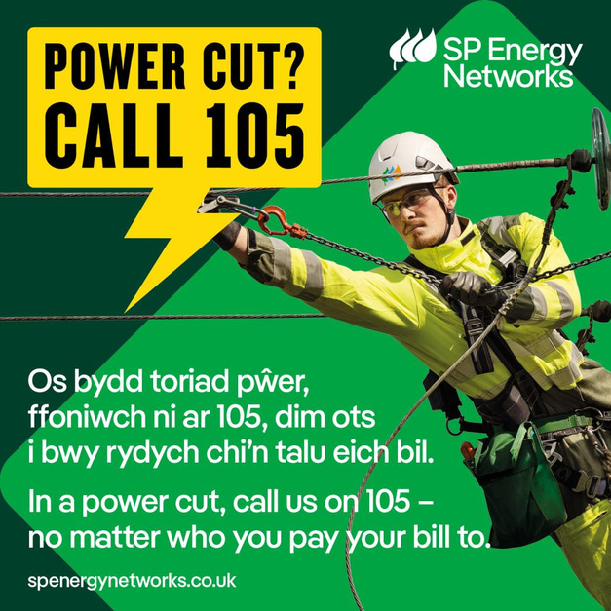
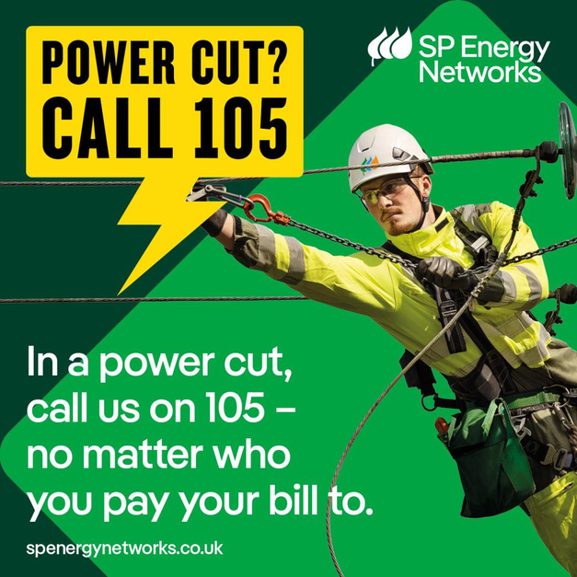
11

Slide 10
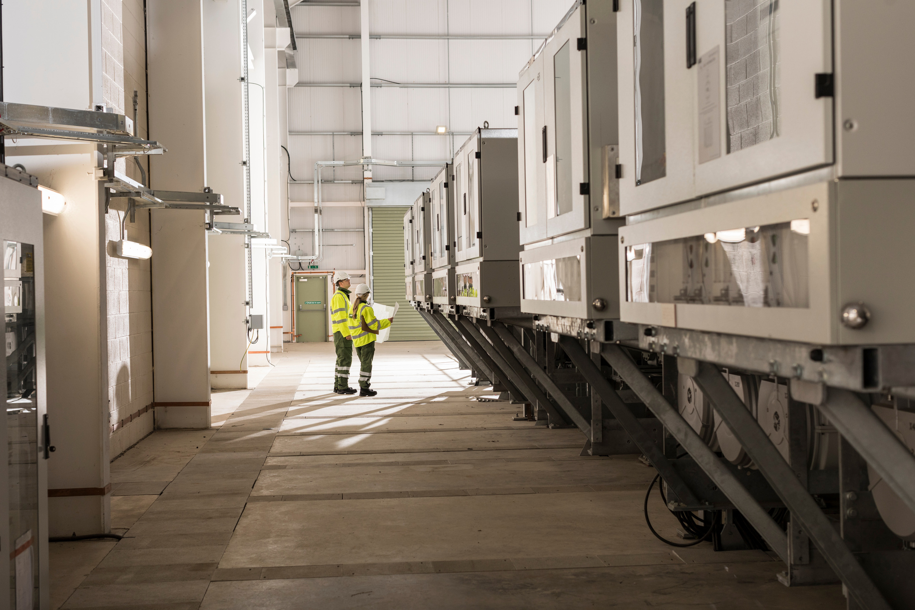
Questions you’ve asked us so far
Why can't you keep King Edward Street open with temporary traffic lights?
We carried out trial holes and site investigations to identify the best route for the new cables. These confirmed that, on King Edward Street, the only viable option that avoids existing underground utilities is through the middle of the road. As the excavation occupies the full width needed for safe working, it is not possible to maintain a traffic lane alongside the works, so a temporary road closure is required.
How will staff reach the doctor’s surgery and local care services?
We’re working to help local businesses understand their options, and liasing with the council to look at SPEN paid car parking to help people access these services.
Where can residents and workers park if access to their usual spaces is unavailable?
Alternative parking locations and eligibility will be published before work starts
Will SP Energy Networks cover additional parking costs?
We are working with the council to explore how we can support you with these addidtional costs.
How will electric vehicle owners who live on King Edwards Road charge their vehicles?
We’re working to utilise local charge points and reinburse car owners.
Will emergency services have access throughout the works?
North Wales Fire & Rescue are looking into making plans to best support the community. We are working with other services to ensure there are suitable plans in place.
Will there be any disruption to train services during the road closure?
Transport for Wales currently has no planned rail improvement works or rail replacement services scheduled during the period of the King Edward Street road closure. Trains are therefore expected to run as normal.
8

Slide 11
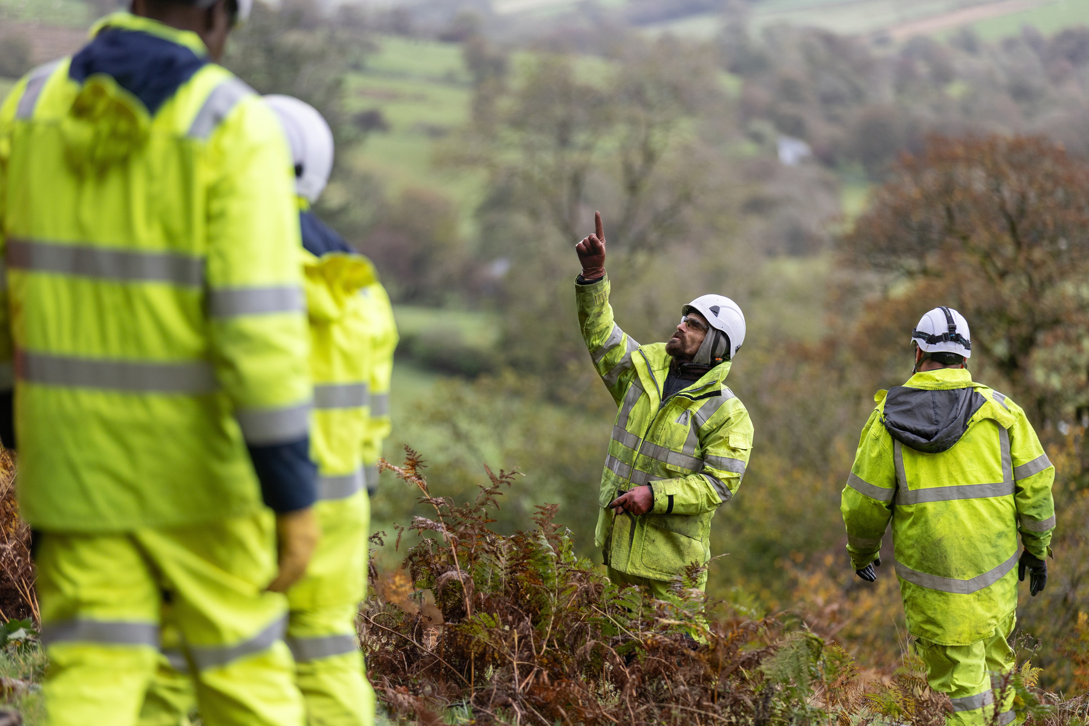
Questions you’ve asked us so far
Why are the works planned for November?
The work was initially proposed for summer, but SP Energy Networks did not approve that timing, so November was agreed instead. Weather conditions in January could also make the work more difficult.
Will residents, businesses and properties on King Edward Street have vehicle access?
No. Vehicles will not have access to King Edward Street during the planned closure from 16 November to 2 December, including access to businesses, properties, homes, garages and shops.
Will pedestrians still be able to use King Edward Street?
Yes. Pedestrians will be able to use King Edward Street throughout the works.
What is the official diversion route, and why is it so long?
The diversion route is managed by Gwynedd Council and is not the responsibility of SP Energy Networks. The council has provided a 44-mile diversion because it considers this to be the safest available alternative route.
What signage will be installed, and where?
Plans should include clear advance signs at the A496/A470 roundabout and on the A487 at Penrhyndeudraeth and Maentwrog, warning of no through access and showing diversion routes with safe turning points.
How will access be managed for schools, rail-replacement services, buses, home deliveries and other essential journeys?
We are working to help schools, Lloyds Coaches, supermarkets, Transport for Wales and other service providers to review their options.
What route must lorries and other large vehicles use?
All lorries and other large vehicles, including vehicles moving caravans, must follow the official 44-mile diversion. There is no accessible or suitable shorter route for these vehicles.
9

Slide 12
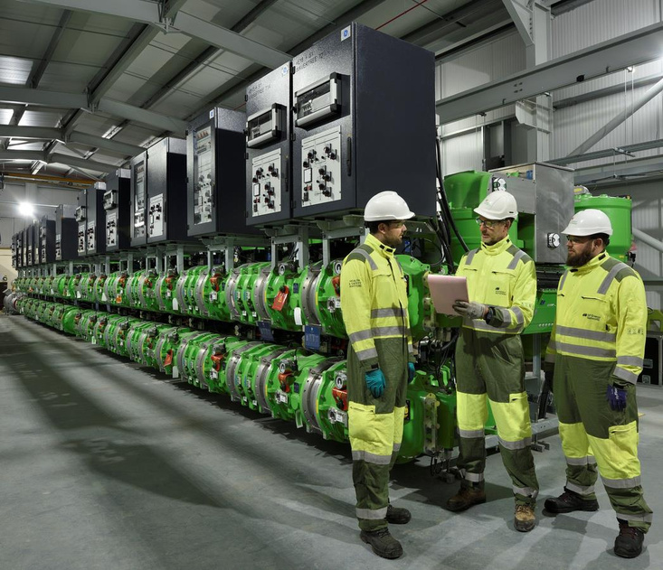

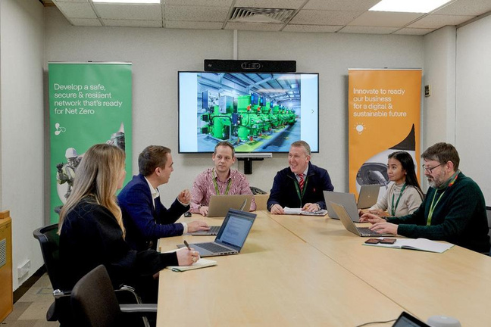
Q&A
12

