Slide 1
Flexible Connections
Euan Norris SPEN
Gavin Stewart SSEN

Slide 2
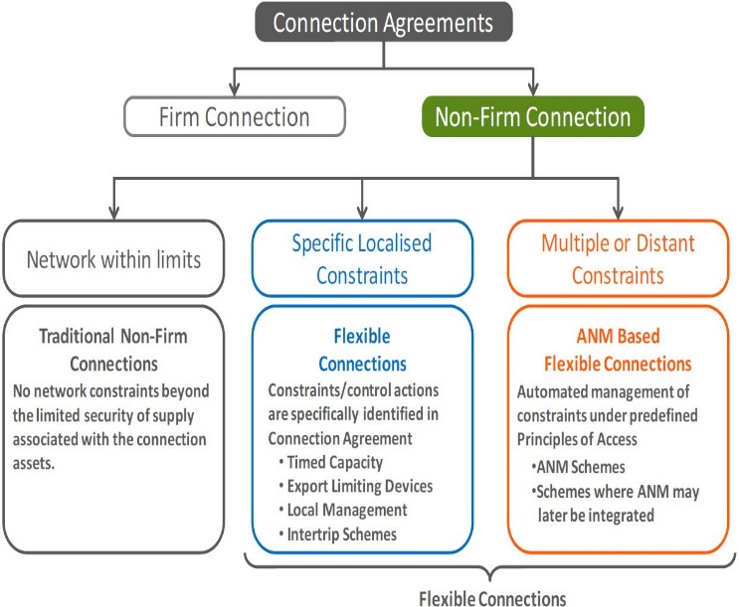
Flexible Connections & Principles of Access Policy Development
Flexible Connections Design Manual Developed
Complements Existing Export Limiting Schemes Policy In Place from January 2016

Slide 3
Flexible Connections: Principles of Access
Principles of Access Document Overview
1
  Facilitates Flexible Connection Solution as BAU
2
Enables connections into constrained network without reinforcement
3
Includes a wide range of Flexible Connection Solutions
4
Outlines Commercial Principles of Access and Queue Management
5
Includes key design considerations for each Solution

Slide 4
Flexible Connection Solutions
Flexible Solution | Description
Timed Capacity Connections | This solution offers a connection with a fixed level of Curtailment. The User manages their import/export level within a prescribed operating schedule agreed within their Connection Agreement
Export Limiting Devices | Automated equipment at the User’s substation which controls the customer’s demand / generation to ensure that the User’s Agreed Export Capacity is not exceeded
Local Management Schemes | Network feeder monitoring is taken from the protection panels located at the User’s site. Capacity is temporarily reduced for prescribed feeder outages or monitored voltages / currents exceeding the limits prescribed in the Connection Agreement
Remote Intertrip Schemes | Capacity is temporarily reduced to a pre-defined level (which may be zero) for prescribed system abnormal network conditions. These may be distant from the customer’s site and are monitored in real-time
Active Network Management | In areas where there are multiple or complex constraints affecting one or more customers, full wide area Active Network Management systems will be implemented. Distribution control systems continually monitor the limits of the network and allocate maximum export limits to customers autonomously in line with agreed Principles of Access

Slide 5
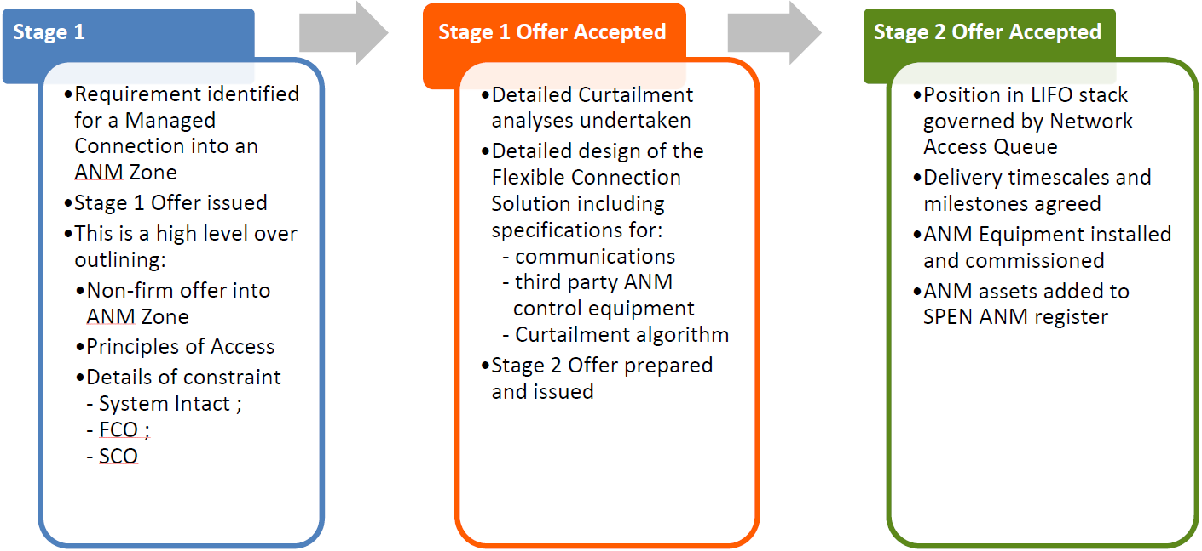
Example of ANM Flexible Connection Offer
Process – Staged Approach
Stage 1 Flexible Connection Offer will be issued outlining ANM solution and will be explicit on the Principles Of Access.
Once an Applicant has accepted a Stage 1 Offer, detailed Curtailment Analysis, design and specification of the ANM scheme and associated communications can be undertaken. Detailed design forms the basis of a Stage 2 Offer.
The position in the LIFO Stack is governed by the Applicant’s position in the Network Access Queue. Detailed Curtailment Analysis may be reassessed upon any changes to the Applicant’s position in the LIFO Stack.

Slide 6
Flexible Connection Solutions – A Whole System Approach
A whole system approach is required to implement Flexible Connection Solutions
Development of New
Commercial
Mechanisms to
Support Flexible
Connection Solutions
Improved Network
Visibility Developed
Through
Implementation of
Enhanced Network
Monitoring
Adoption and
Implementation
Flexible Connection
Solutions
Interoperability with
Third Party Assets
in order to
Exercise Real-Time,
Autonomous Control
Development of IT/
Energy
Management Systems
to Host and Access
Enhanced Network Data
Implementation of Wide
Area Communications and
Autonomous Control
Enabling Infrastructure

Slide 7
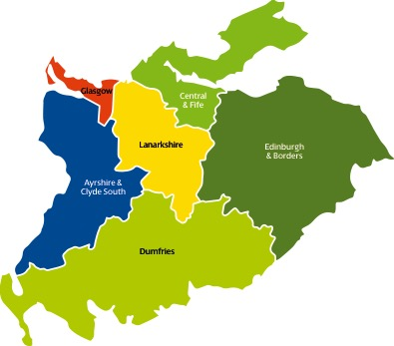
Flexible Connections: Early Engagement with SP Energy Networks Critical
Distributed Generation Experts
Glasgow & Clyde North
Kenny Spence
Central & Fife
Tony Sneddon
Ayrshire & Clyde South
Philip McLellan
Lanarkshire
Derek Jessamine
Dumfries
Stuart Love
Victoria Provan
Edinburgh & Borders
Jerome Bell
For more information log onto www.spenergynetworks.co.uk/gettingconnected

Slide 8
Thank You

Slide 9
Introduction
What are flexible connections and why are we doing them?
Flexible connections examples– Active Network Management (ANM), SGANM, 3rd Party ANM, Timed Export Limitation and Export Limitation
Application process

Slide 10
Flexible Connections Types, Functionality and Architecture

Slide 11
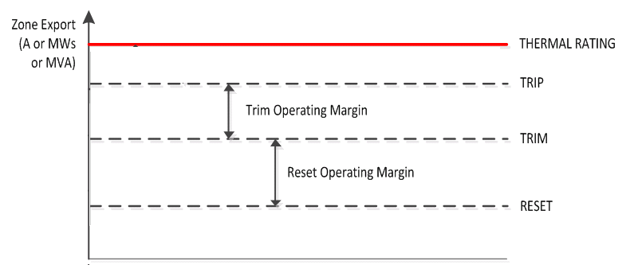
SGANM
Single Generator Active Network Management
Proof of concept to BaU
Alternative to reinforcement
Established methodology and procedures
Single generator
Two monitored constraints maximum
Evolves into ANM

Slide 12
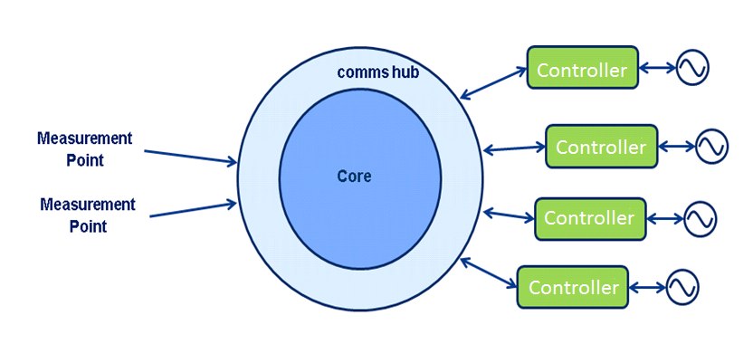
ANM
Active Network Management
Alternative to reinforcement
Established methodology and procedures
Multiple constraints and generators
Expansion of SGANM
Assessed on a scheme by scheme basis

Slide 13
Shared Capacity - Architecture
Generator A
Generator ANM Scheme
Generator B
3rd Party ANM– Shared Capacity
SHEPD/SEPD and Customer Boundary
Disconnection Device
Disconnection Device
Measurement Point
Measurement Point
RTU – Whirl Code
Communications Link
RTU – Whirl Code
NMC SCADA
NMC SCADA

Slide 14
Demand Management - Architecture
Generator A
Generator ANM Scheme
Generator B
3rd party ANM – Demand Management
SHEPD/SEPD and Customer Boundary
Disconnection Device
Disconnection Device
Measurement Point
Measurement Point
RTU – Whirl Code
Communications Link
RTU – Whirl Code
NMC SCADA
NMC SCADA

Slide 15
Timed Export Limitation – Architecture
Generator
SHEPD/SEPD and Customer Boundary
Disconnection Device
Measurement Point
RTU – Whirl Code
NMC SCADA

Slide 17
Commercial – Application Process

Slide 18
Pre-application Requirements
Should hold a Standard Quotation that is within its validity period (which is 90 days after the Quotation is issued), in some cases a flexible offer can be run in parallel with a traditional offer.
Can find out more about what flexible options may be available by following this link
https://www.ssen.co.uk/AlternativeGenerationConnections/
Thermal constraints only
Only applicable to generation

Slide 19
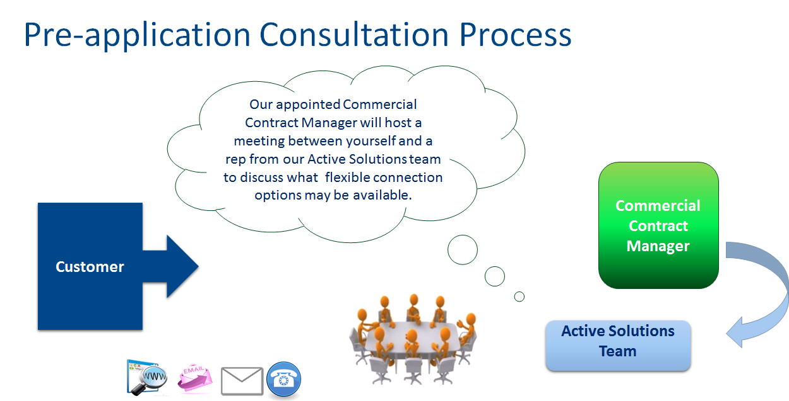
Pre-application Consultation Process

Slide 20
Commercial Aspects
We don’t do curtailment assessment ourselves
Your ‘queue position’ can be maintained between traditional and flexible if going from one to the other
A flexible generation connection offer will provide for an enhanced scheme not a minimum scheme
SSEN won’t get involved in 3rd Party commercial agreements between 3rd Party ANM parties
In order to operate flexible generation connections we are required to publish and share certain network information
We will use your data to help all other applicants who are interested in flexible connections

Slide 21
Summary
Described what flexible connections are and why they are used
Went through flexible connection examples– Active Network Management (ANM), SGANM, 3rd Party ANM, Timed Export Limitation and Export Limitation
Discussed the Application process

Slide 22

Questions

