Slide 1

ICE 5.4 – LCT EXAMPLE INFORMATION PACK
EVs and HPs

Slide 2
Contents
LCT Connections Process Outline for Large Commercial Customers………………………………3
Electric Vehicles – Types of Charger………………………………………………………………………………4
Electric Vehicle - Fast Charger Examples……………………………………………………………………….6-7
Electric Vehicles – Rapid Charger Examples……………………………………………………………………8-9
Electric Vehicles – Ultra Rapid Chargers Examples………………………………………………………….10
Heat Pumps – Types of Heat Pump………………………………………………………………………………..11
Heat Pumps – 100 home Scenario………………………………………………………………………………….12
Heat Pumps – 600 home Scenario…..…………………………………………………………………………….13
Heat Pumps – 1,200 home Scenario………………………………………………………………………………14

Slide 3
LCT Connection Process Outline for Large Commercial Customers
1 - ICE customer approaches SPEN requesting a connection.
2 – We must Identify load growth and associated network capacity and constraints.
3 - Network Requirements
4 - Additional Requirements
5 - Customer Quote/ Design Approval
6 - Project Delivery
Location
Demand Increase
Constraints
Connection
Reinforcement
Reconfiguration
Significant projects going on in local network.
Future proof network for growth
Customer priorities
Design solution costing
Delivery time frame
After design approved and paid for project can be delivered in agreed timeframe.

Slide 4
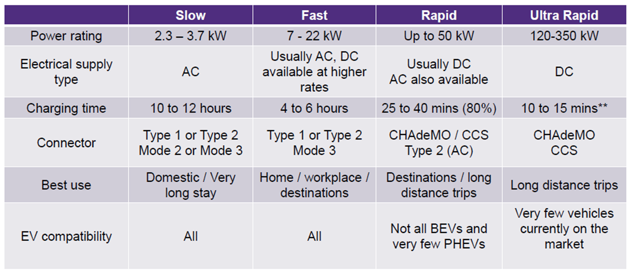
Electric Vehicles – Types of Charger
Electric vehicles (EVs) are classed as a low carbon technology and can help the UK meet its carbon emission ambitions. The UK Government has set an ambitious target to ban the sale of petrol and diesel cars by 2030, and the Scottish Government by 2032, which will accelerate the transition to electrified transport for all.
An EV refers to a vehicle that runs completely on battery power. Usually EVs will be charged overnight with slow chargers that take longer to charge the vehicle. There are also commercial “rapid” chargers available that can quickly get the car up to a full charge.
The time, cost & impact on the network will depend on what you want to connect. The following should only be used as a guide as costs and time scales may differ depending various aspects like network constraints, such as distance to cables or available capacity.

Slide 5
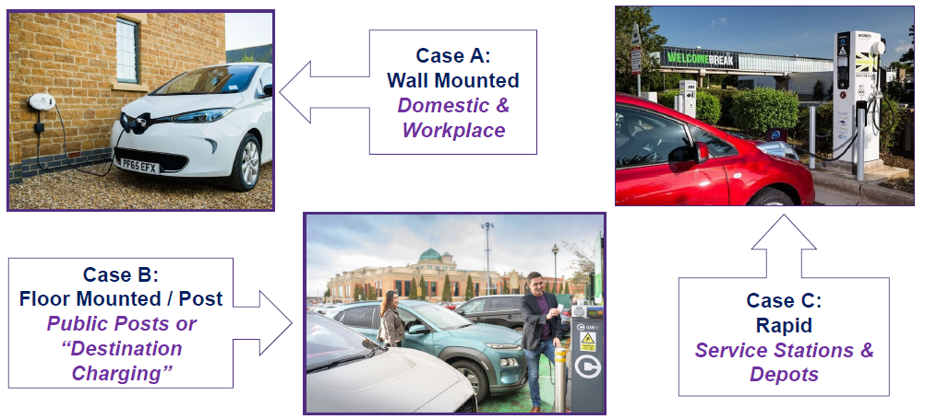
Types of Chargepoint

Slide 6
Electric Vehicles – Fast Chargers
Scenario
A customer (for example a large commercial office building) wants to install 30 fast chargers for their employees to charge their EV’s during work hours.
Load Growth
Assuming a fast charger demands 7kW, the site would demand 210kW of additional load from the local network. We would then assess the network to determine whether there is capacity for this to be connected, or whether the network is constrained and needs to be reinforced.
Network Requirements
Additional Requirements
Customer Quote/ Design Approval
Project Delivery
Once the quote has been approved, the connection can then be delivered.
Any additional requirements will also be considered, such as; does the customer anticipate similar projects at this location – can we futureproof the connection by designing for higher capacity than is being currently installed.
A suitable solution for the connection is then identified, and the network requirements defined.
In this case, the existing secondary substation is rated at 500kVA and has a maximum demand of 330kW. Therefore to allow the installation of 30 fast EV chargers the existing secondary would need upgraded to a 1000kVA, in addition to this we would need to upgrade the existing cable infrastructure and install new service cables for the charge points.
We can then cost the most appropriate design and provide a timeframe for its delivery. This will be summarised to the customer in the form of a quote. For this example, the cost of the connection would be approximately £30,000 and take 6 month to a year to deliver.

Slide 7
Electric Vehicles – Rapid Chargers
Scenario
A customer (for example a service station) wants to install 5 rapid EV chargers to provide quick charging for road users.
Load Growth
Assuming a fast charger demands 50kW, the site would demand 250kW of additional load from the local network. We would then assess the network to determine whether there is capacity for this to be connected, or whether the network is constrained and needs to be reinforced.
Network Requirements
Additional Requirements
Customer Quote/ Design Approval
Project Delivery
Once the quote has been approved, the connection can then be delivered.
Any additional requirements will also be considered, such as; does the customer anticipate similar projects at this location – can we futureproof the connection by designing for higher capacity than is being currently installed.
We can then cost the most appropriate design and provide a timeframe for its delivery. This will be summarised to the customer in the form of a quote. For this particular example, the cost of the connection would be approximately £75k and take 12 months to deliver.
A suitable solution for the connection is then identified, and the network requirements defined.
For 5 fast EV chargers at a site, the connection will likely require an additional secondary sub-station to be built near the site, with underground LV and service cables then feeding into the chargers. Alternatively, if the site is nearby multiple existing sub-stations, capacity could be extracted from these instead.

Slide 8
Electric Vehicles – Rapid Chargers
Scenario
A customer (for example a shopping centre owner) wants to install 20 rapid chargers in their car park for customer use.
Assuming a rapid charger demands 50kW, the site’s demand would increase by 1MW. With this information we would then assess the network to determine whether there is capacity for this to be connected, or whether the network is constrained and needs to be reinforced.
Network Requirements
Additional Requirements
Customer Quote/ Design Approval
Project Delivery
Once the quote has been approved, the connection can then be delivered.
Any additional requirements will also be considered, such as; does the customer anticipate similar projects at this location – can we futureproof the connection by designing for higher capacity than is being currently installed.
Load Growth
A suitable solution for the connection is then identified, and the network requirements defined.
In this case, considering charging diversity, a new 1,000 kVA secondary substation would need installed and depending on specific network requirements ether network reconfiguration or a new primary substation would also be required. On top of this new 11kV cable, LV mains and some LV service cable would be required to connect the charge points to the network and potentially 33kV cable if required.
We can then cost the most appropriate design and provide a timeframe for its delivery. This will be summarised to the customer in the form of a quote. For this example, the cost of the connection would be approximately £0.5m including upgrades to the primary substation and take 1-2 years to deliver.

Slide 9
Electric Vehicles – Ultra Rapid Chargers
Scenario
A customer (for example a local council) wants to install 3 ultra rapid EV chargers in a layby to provide quick charging for road users.
Load Growth
Assuming a rapid charger demands 120kW, the site’s demand would increase by 360kW. With this information we would then assess the network to determine whether there is capacity for this to be connected, or whether the network is constrained and needs to be reinforced.
Network Requirements
Additional Requirements
Customer Quote/ Design Approval
Project Delivery
Once the quote has been approved, the connection can then be delivered.
Any additional requirements will also be considered, such as; does the customer anticipate similar projects at this location – can we futureproof the connection by designing for higher capacity than is being currently installed.
A suitable solution for the connection is then identified, and the network requirements defined.
We can then cost the most appropriate design and provide a timeframe for its delivery. This will be summarised to the customer in the form of a quote. For this example, the cost of the connection would be approximately £20k and take 3-6 months to deliver.
As this example is a Layby we must assume it is a rural location, and therefore any existing nearby secondary substations or transformers are of a low capacity (<50kW). From this we would propose that any existing substations or transformers are uprated to 500kVA or 1000kVA depending on local load requirements, in addition to this some 11kV conductor, poles and LV cabling would also be required.

Slide 10
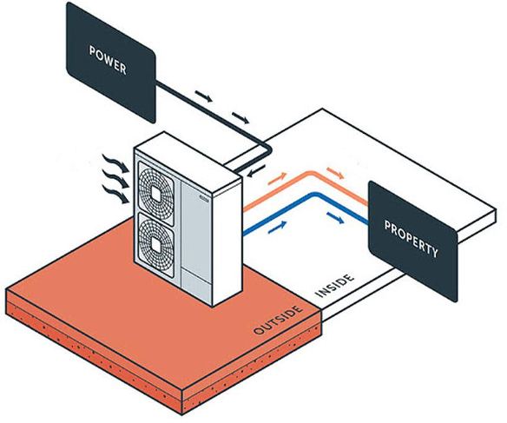
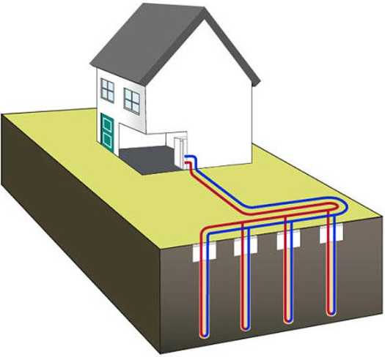
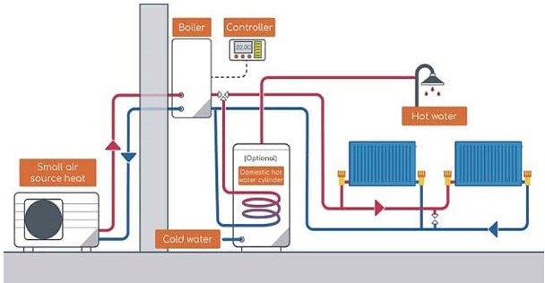
Heat Pumps– Types of Heat Pump
Heat pumps (HPs) are classed as a low carbon technology and can help the UK meet its carbon emission ambition. The UK Government has set an ambitious target to install up to 600,000 heat pumps per year by 2028 to accelerate the replacement of gas boilers with zero carbon alternatives. This is part of the UK Government’s plan to achieve Net Zero by 2050, with the Scottish Government targeting Net Zero by 2045.
A heat pump (HP) is an electrical alternative to gas boilers and other types of boilers used to provide space and water heating (and cooling) to people’s homes, businesses and properties. There are three main types of heat pumps that are common in the UK marketplace. These are air source heat pumps, ground source heat pumps and hybrid heat pumps.
The time, cost & impact on the network will depend on what you want to connect. The following should only be used as a guide as costs and time scales may differ depending various aspects like network constraints, such as distance to cables or available capacity.

Slide 11
Heat Pump – 100 homes
Scenario
A customer (for example a Housing Association) has proposed turning approximately 100 houses from natural gas heating to heat pumps.
Load Growth
Assuming a HP demands 8kW, this would increase the load on the local network by 800kW. With this information we would then assess the network to determine whether there is capacity for this to be connected, or whether the network is constrained and needs to be reinforced.
Network Requirements
Additional Requirements
Customer Quote/ Design Approval
Project Delivery
Once the quote has been approved, the connection can then be delivered.
Any additional requirements will also be considered, such as; does the customer anticipate similar projects at this location – can we futureproof the connection by designing for higher capacity than is being currently installed.
A suitable solution for the connection is then identified, and the network requirements defined.
We can then cost the most appropriate design and provide a timeframe for its delivery. This will be summarised to the customer in the form of a quote. For this example, the cost of the connection would be approximately £100k and take 1-2 years to deliver.
Under this scenario existing secondary substations would require uprating. Assuming an existing demand of 150kW (after diversity) and the existing substation is 800kW, the new load would be 950kW. Therefore the existing substation would require uprating to 1000kVA. In addition the LV mains cable might also require upgrading or the local network reconfigured to better share the load between two substations.

Slide 12
Heat Pump – 600 homes
Scenario
A customer (for example a Housing Association) has proposed turning approximately 600 houses from natural gas heating to heat pumps.
Load Growth
Assuming a HP demands 8kW, this would increase the load on the local network by 4.8MW. With this information we would then assess the network to determine whether there is capacity for this to be connected, or whether the network is constrained and needs to be reinforced.
Network Requirements
Additional Requirements
Customer Quote/ Design Approval
Project Delivery
Once the quote has been approved, the connection can then be delivered.
Any additional requirements will also be considered, such as; does the customer anticipate similar projects at this location – can we futureproof the connection by designing for higher capacity than is being currently installed.
A suitable solution for the connection is then identified, and the network requirements defined.
We then cost the best design solution to provide the customer with a quote as to the scale of the required works and also the cost.
Considering primary reinforcement and 6 new secondary substations along with cabling this example would be in the region of £0.5-1m and take 2-3 years to deliver.
Under this scenario existing secondary substations would require uprating. Assuming an existing demand of 900kW (after diversity) and the existing 11kV network comprises of two 500kVA transformers, the new maximum load would be 5.7MW. Therefore the existing substation would require uprating to 1000kVA, and an additional four 1000kVA installed. In addition the LV mains cable might also require upgrading and new LV cables installed to connect in the new secondary substations. It can also be reasonably assumed that reinforcement would be required at the primary substation.

Slide 13
Heat Pump – 1,200 homes
Scenario
A customer (for example a Housing Association) has proposed turning approximately 1,200 houses from natural gas heating to heat pumps.
Load Growth
Assuming a HP demands 8kW, this would increase the load on the local network by 9.6MW. With this information we would then assess the network to determine whether there is capacity for this to be connected, or whether the network is constrained and needs to be reinforced.
Network Requirements
Additional Requirements
Customer Quote/ Design Approval
Project Delivery
Once the quote has been approved, the connection can then be delivered.
Any additional requirements will also be considered, such as; does the customer anticipate similar projects at this location – can we futureproof the connection by designing for higher capacity than is being currently installed.
A suitable solution for the connection is then identified, and the network requirements defined.
We then cost the best design solution to provide the customer with a quote as to the scale of the required works and also the cost.
Considering primary reinforcement and 12 new secondary substations along with cabling this example would be in the region of £10-15m and take 3-5 years to deliver.
Under this scenario the existing secondary substations would require uprating. Assuming an existing demand of 1,800kW (after diversity) and the existing 11kV network comprising of four 500kVA transformers, the new maximum load would be 11.4MW. Therefore the existing substations would require uprating to 1000kVA, and an additional eight 1000kVA substations installed. In addition the LV mains cable might also require upgrading and new LV cables installed to connect in the new secondary substations. Reinforcement would be required at the primary substation due to the increase in demand.

