Slide 1
SPM Competition in Connections Workshop
April 2018

Slide 2


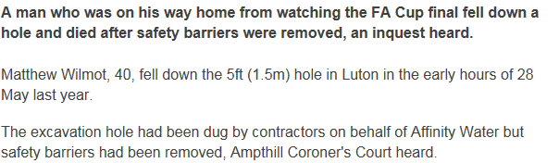
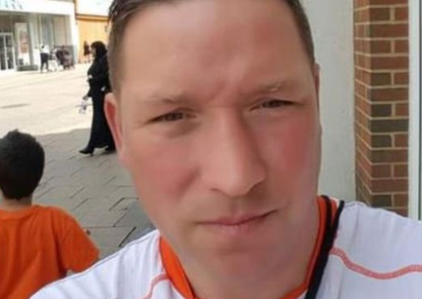
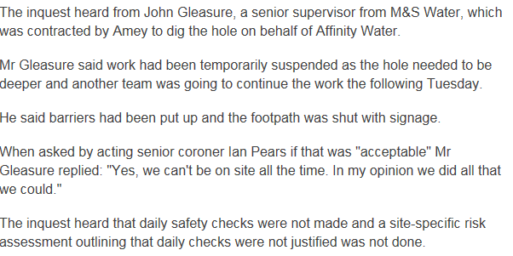
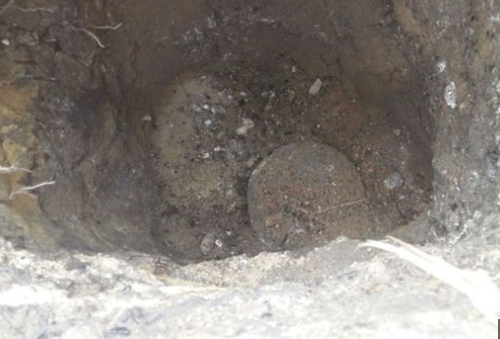
Safety Contact
2

Slide 3
Welcome
Andy Churchman

Slide 4
Agenda
09:00 Registration/ Tea & Coffee
09.30 Welcome & Introduction
09:45 Emergency Response
10:15 GTC
10.40 Coffee Break
11.00 Radar
11.20 Land Rights
11:50 A&D Fees/ Connection Offer Fees
12:10 ICE
12.45 Summary and Next Steps
13.00 Close & Lunch

Slide 5
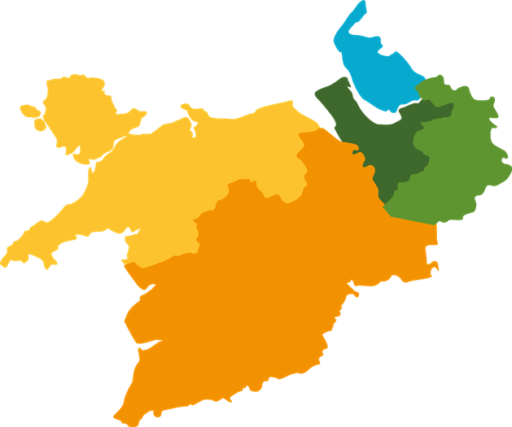
SP Manweb Update – Areas of Responsibility
North Wales
District Manager- Andy Churchman
Head of Planning & Design- Terry Jones
Head of Delivery- John Heathman
Wirral
District Manager- Jane Wilkie
Head of Planning & Design- Dewi Jones
Head of Delivery- John McWilliams
Dee Valley/ Mid Wales
District Manager - Liam O’Sullivan
Head of Planning & Design- Gary Barnes
Head of Delivery- John Heathman
Merseyside
District Manager- Andrew Lloyd
Head of Planning & Design- Neil Woodcock
Head of Delivery- Mark Barry
Mid Cheshire
District Manager- Tom Walsh
Head of Planning & Design- Ken Brassington
Head of Delivery- Andy Jewell
132kV Business SP Manweb
Business General Manager – Alyn Jones/ Mark Sobczak
132kV Programme Delivery Manager
Huw Thomas
Andy Churchman has overall responsibility for all Connections Activities in SP Manweb

Slide 6
SP Manweb Update – Other Engagement Contacts
Land & Planning
Ross Baxter - Land & Planning Manager
Jo Baugh - Land Team Leader
System Design
Sue Pilcher & Keith Evans
Lead Engineers, System Design Merseyside
Andy Beddoes & Jon Mitchell
Lead Engineers, System Design North Wales
Mark Lyon & Myles Buckley
Lead Engineers, System Design Cheshire
Stakeholder Engagement Team
Rachel Shorney - Stakeholder Engagement Manager, SP Manweb
Louise Taylor - Customer Engagement Manager, SP Manweb

Slide 7
Emergency Response
Alyn Jones

Slide 8


Agenda
Introduction
Process Overview
Managing Safety
Further Information

Slide 9
Alyn Jones 132kV Networks General Manager
Joined Manweb 3rd September 1978 as a Student Engineer
First real job - Ince ’B’ Power Station
132kV Transmission, 3rd Engineer > 2nd Engineer
Senior Control Engineer
Control Room Manager
Network Control Section Head
Emergency Planning Manager
Operations Manager England & Wales
Blackstart and Network Continuity Manager - ED1 price review
132kV General Manager
Mid Cheshire District General Manager
Many projects along the way
External
NEWSAC rep /Chair, E3C member (ETG and CTG) &
EPMF member

Slide 10
IDNO Fault Response Service
Introduction
All DNOs were requested to provide fault response service to IDNOs under CiC Code of Practice – this initiative was subsequently included in SPEN’s 2016/17 ICE Plan
Desire for like-for-like service for connected customers regardless of DNO / IDNO connection
SPEN have worked with GTC over the past 18 months to develop the service provision and have now signed an agreement with GTC
Went live in December 2017 – preceded by a desk top ‘end to end’ trial run
The service has been utilised, generally operated inline with agreed process but inevitably there have been a few areas to learn from, and importantly we have;
Established a Quarterly Review meetings as a platform for continuous improvement
This is a commercial agreement between SPEN & GTC (non-regulated activity); however, SPEN would plan to offer a similar service on similar terms to any interested IDNO
IDNO Fault Response

Slide 11
IDNO Fault Response Implementation
Process Overview
Contract enables IDNO to request SPEN to respond to incidents which occur on their network.
Incidents passed via IDNO call centre to SPEN control centre teams:
If IDNO customers call in to SPEN, they will be redirected to IDNO in the first instance to assess call and make decision on response requirements.
Incidents managed via SPEN’s PowerOn system, broadly in line with our existing fault management processes.
District faults teams responsible for prioritisation and delivery of repairs – commitment to provide a similar service level as to SPEN connected customers.
Incident updates provided to IDNO to enable appropriate customer updates to be provided by the IDNO to their customers.
IDNO Fault Response

Slide 12
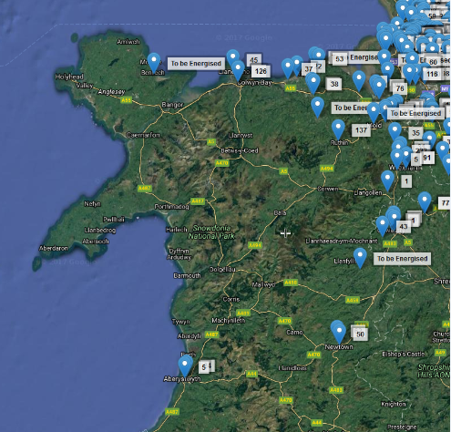
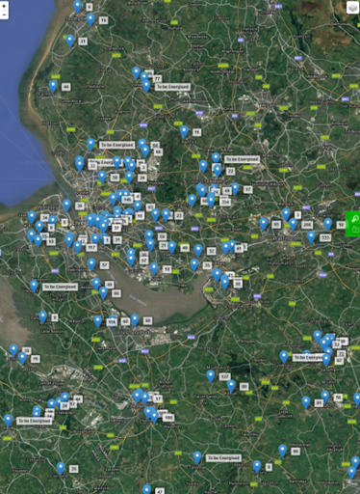
IDNO Fault Response Implementation
GTC have many sites across SPM’s highly populated urban areas of Cheshire, Merseyside and the Wirral, but also reach into Wales. With a connected customer base > 0.5% of SPM’s – not an insignificant challenge
IDNO Fault Response

Slide 13
IDNO Fault Response Implementation
Managing Safety (1)
SP safety rules (PSSI 17) updated to provide process for SPEN to work on IDNO networks – all work carried out under SP safety rules.
IDNO networks will be handed over to SPEN for duration of fault repair.
Handover paperwork will detail all necessary information to ensure safe transfer of control from IDNO to SPEN:
LV network control transferred to SPEN authorised person (e.g. jointer/TCP)
HV network control (SPD only) transferred to SPEN control engineer
All relevant drawings, including required utility drawings, passed over to SPEN at point of request to attend
IDNO Fault Response

Slide 14
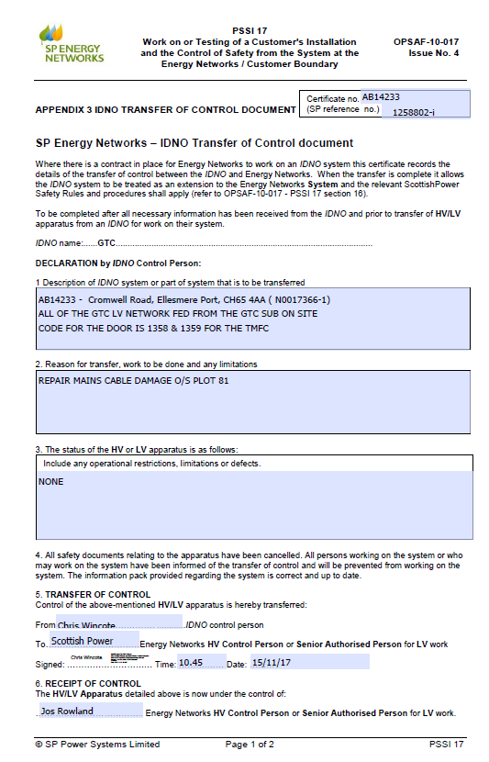
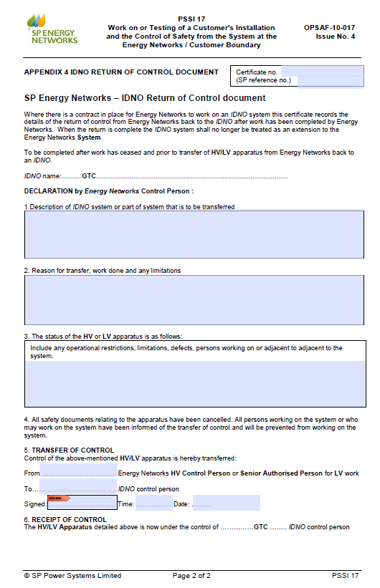
Transfer of control – Formal Procedure PSSI 17 updated to accommodate IDNO
What?
Why?
Status?
Transfer to SPEN
Return to IDNO

Slide 15
IDNO Fault Response Implementation
Managing Safety (2)
Expectation is that IDNO networks are installed to SPEN standards with generally accurate cable records available to SPEN.
Assumption cables and joints used are typically similar to those used on SPEN network.
All repair work subject to SPEN staff being appropriately authorised and trained to work on the IDNO’s specific assets.
HV networks will be assessed on a case by case basis. Where equipment is similar to that installed on SPEN network then provision for HV restoration / repair can be included. Additional documentation required for transfer of control for HV networks (e.g. detail of operational restrictions, confirmation of maintenance regime).
IDNO Fault Response

Slide 16
IDNO Fault Response Implementation
HV Incident Process
IDNO issue workpack including network drawings, cable records, control transfer document, relevant plant information and any other relevant information. Information sent to dedicated mailbox.
SPEN accept transfer of Network Control from GTC to SPEN Control Engineer (appropriate Control desk dependent on location of network).
Job resourced in line with normal HV fault resourcing process.
SPEN engineer confirms trip of customer CB and isolates IDNO network.
EFIs used to identity faulty section, with SFT then issued to confirm fault.
Once faulty section isolated and earthed, network re-energised from SPEN source CB & closure of normally open point.
Fault location and repair progressed by District (BAU processes)
Control transferred back by SPEN control engineer to GTC.
IDNO Fault Response

Slide 17
IDNO Fault Response Implementation
Streetworks Process
All excavations undertaken in the public highway relating to IDNO faults are undertaken under the license of the IDNO who owns the asset.
The IDNO is responsible for raising, managing and closing the notice.
SPEN must provide the IDNO with the relevant information to enable noticing to be carried out in line with statutory requirements and timescales.
The details of excavations must be noted in the PowerOn log and communicated by the Incident Controller to the IDNO to enable the notice to be raised.
On completion of work, the District faults team must notify the IDNO of completion of works (including reinstatement if applicable) to enable the notice to be closed (this will require a discussion with local cable-lay contractor).
IDNO Fault Response

Slide 18
IDNO Fault Response Implementation
Billing and Reporting
Annual retainer due in advance of contract implementation – retainer based on setup fee + charge per MPAN.
Incidents billed retrospectively on completion of the incident and receipt of all contractor invoices (if relevant).
Fixed rates for common jobs (e.g. call out for single premise incident – cut-out fuse replacement).
Reporting pack with relevant info on customer interruptions, asset repairs provided on completion.
IDNO Fault Response

Slide 19
Improvements and delighting customers
SP Energy Networks ICP seminar

Slide 20
David Overman
Apprentice and Electrical Engineer with Eastern Electricity
Developed electrical supply chain business across the UK
Established Wind Farm construction business
Worked as contractor with SP Manweb
Began the GTC electricity business in 2006
Instrumental in changes in connections market and Code of Practice development

Slide 21
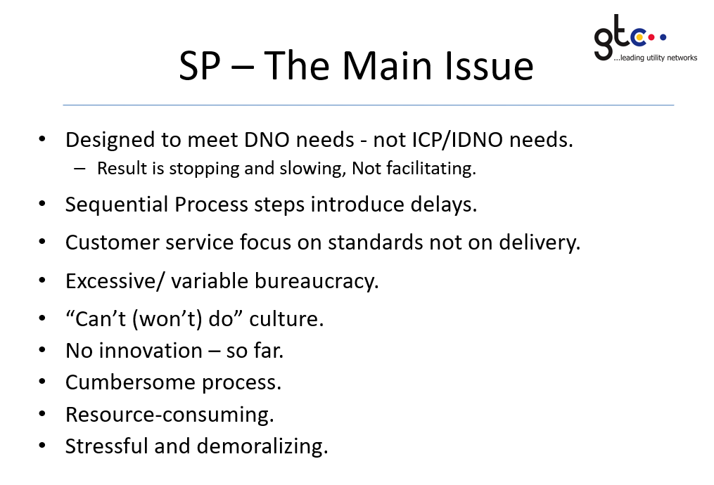
Where have we been……
Meetings held both in Scotland and our offices – no real connection with Manweb team.
This where we were 2011
What has changed over the years
An area identified not to work in.
Relied on others to work in SPEN
Identified potential ‘anti-competitive’ actions.
Lack of customer focus

Slide 22
What has changed
Legals resolved – last of all DNOs and 6 years after first DNO
Network records – best in all DNOs
Emergency response service provided – first class service
Engagement has started at a more senior level
Commitment to change
HV connection process prior to legal completion

Slide 23
Areas to improve/change
RADAR – not customer friendly or helpful
Self connect process – use of ‘Option 4’
Consistency within areas and the two regions
Communication within SPEN
POC application process for IDNO networks

Slide 24
Areas to improve/change
Timely intervention on issues
Connection process of HV pressure testing (witnessing of test?)
Regular connections meeting looking at improvements to process
Connection drop in design meetings
Training on Competition Law

Slide 25
Best practice across DNOs
UKPN – Self approval of Design
WPD - Option 4 HV and LV self connect process
Various - Self assessment of points of connection
Various - Escalation process
Various – Being treated as a customer.

Slide 26
Best practice across DNOs
Various - Self serve process wherever possible
Various – a CiC focal point
Various - Approved design is what is built and energised
Various – Contact detail on emails (has improved)

Slide 27
Next steps
Workshop with all interested customers invited
Commitment to change systems/ process
Undertake Competition Law training
Set out improvement plan within ICE plan
Regular updates and customer involvement

Slide 28
Questions

Slide 29
BREAK

Slide 30
RAdAR
Alastair Oldfield

Slide 31
RAdAR Q & A
Proposed RAdAR Changes:
Update to the system to reflect Section 16 Dual Offer Unmetered Quotes being issued.
No changes to the existing processes.
There will now be the option for an applicant to accept the POC element of a Section 16 Dual Offer Quote and then appoint an ICP to Design and Construct the job.
For the POC module this will follow the Dual Offer Process and for Design, Construction and Connection the metered process will be followed.
The main alterations will be to the naming conventions of sections in the system, with the inclusion of a new process flow through the system.
RAdAR Q & A

Slide 32
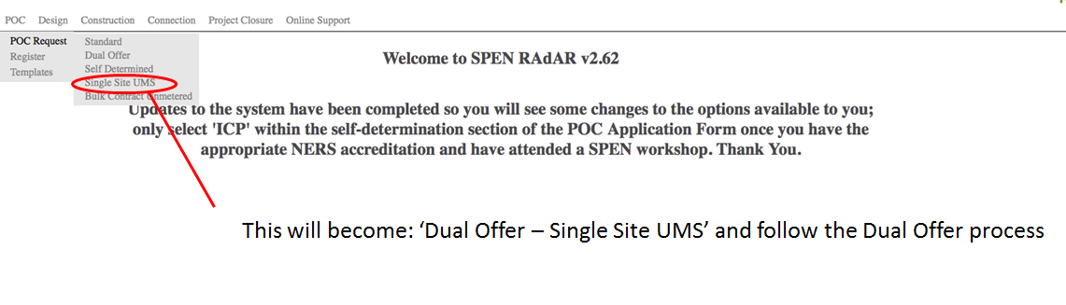
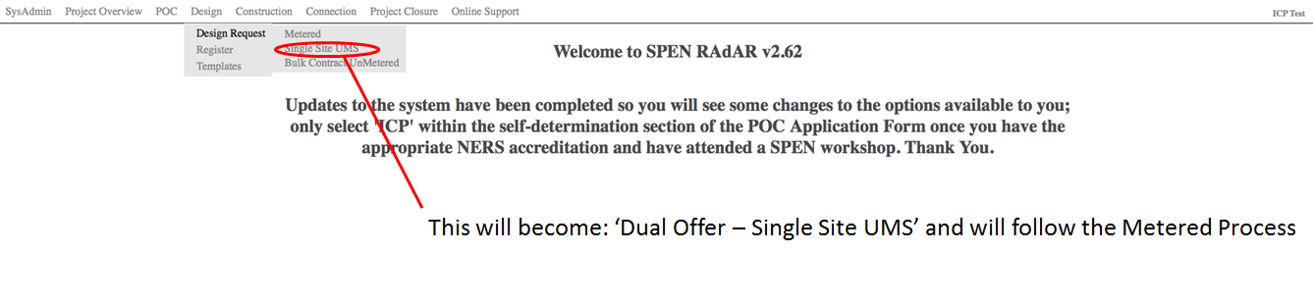
RAdAR Q & A
Screenshots from the test environment to show some of the changes proposed
Development is currently coming to an end.
The changes to the system are undergoing UAT.

Slide 33


RAdAR Q & A
RAdAR Training Material:
Training material for RAdAR has been revised to align with the changes and hopefully make it more “User Friendly” to understand.
A separate manual has been created for each module in the system. The process documents will remain the same.
The original Trifold manuals will be archived and replaced by these single training manuals.
http://www.spenergynetworks.co.uk/pages/radar_training_materials.asp
RAdAR Q & A

Slide 34
RAdAR Q & A
Questions?
RAdAR Q & A

Slide 35
Land Rights
Jo Baugh

Slide 36
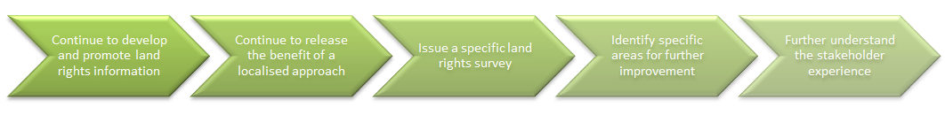
Land & Planning Update
Our journey:
What we said in October 2017:
Re-write the connection offer letter to include more information on Land Rights
Further training for internal staff of our approach to Land Rights to ensure accurate information is provided to customers at design stage and during monthly updates
Develop the Land & Planning section of the website to include specific information for connection customers; including timelines and potential delays
Process of escalation within the Business to ensure decisions on the type of Land Rights versus the risks are made at appropriate levels
PMs will have access to the Land Rights systems and Land Team will be managed against monthly update targets

Slide 37
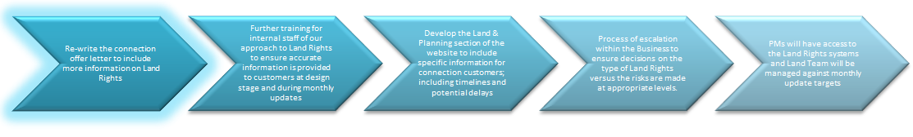
Offer Letter Content
Land Rights
The term “Land Rights” is used as a collective term used by Us to cover the acquisition of property rights, such as freehold and leasehold interests, a lease or purchase or servitudes, easements or wayleaves, that We will require to be in place for Our Works before we can connect your project to the Distributor’s System.
Our Land Rights approach is to obtain the most appropriate Land Rights in order to maintain a secure supply of electricity to You.
Responsibilities – You do / We do
You should take the following key factors into consideration when planning your connection:
We do not seek such consents until You have accepted this Offer
We require the consent of any land owner affected by the Project prior to beginning Our Works.
The timescales associated with obtaining Land Rights may affect the timescales for connection of your project to the Distributor’s System, however, We will keep you updated at reasonable intervals.
We cannot undertake Our Works on third party land until all Land Rights have been obtained.
Typical timescales in order to secure Land Rights may be from 3 to 45 weeks, however, timescales will vary depending on the nature of the project.
We will keep you regularly informed as to the progress towards gaining our Land Rights.
Cost of Land Rights
There will be a cost payable by You attributable to obtaining Land Rights for Our Works. This cost may be subject to variation following Your acceptance of this Offer Letter and any necessary land referencing having been carried out. We will inform You of any changes to this cost.

Slide 38
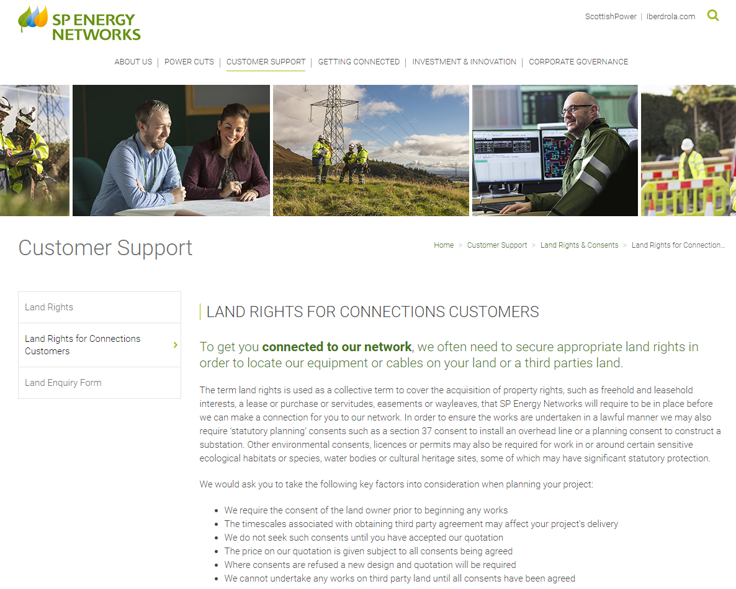

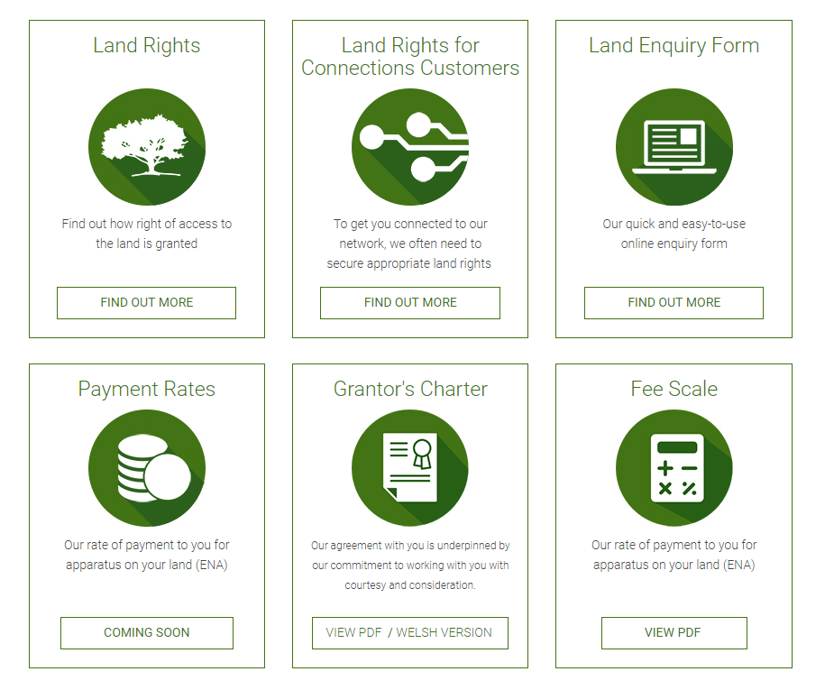
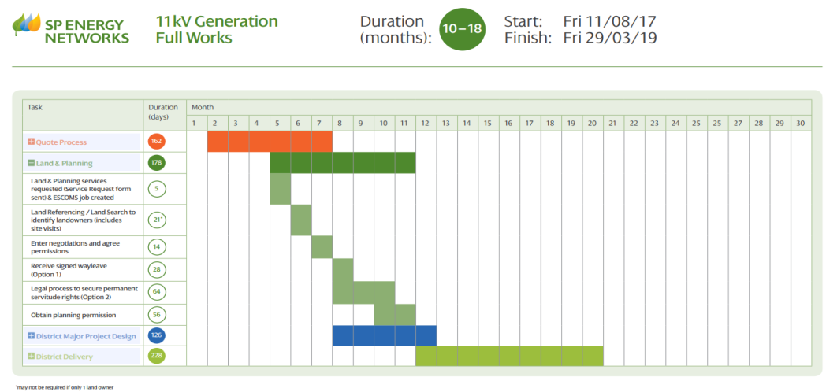
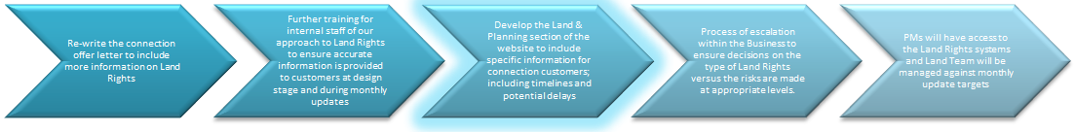
Website Development
Customer focus
Loops to the connections website
Clearer timescales

Slide 39
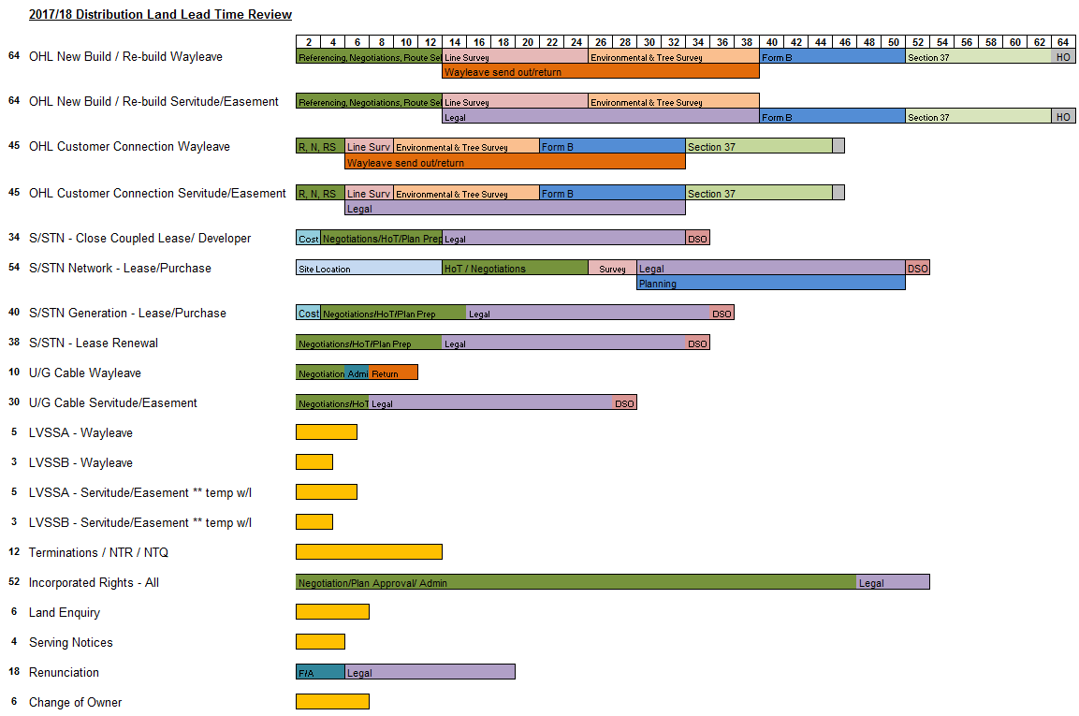
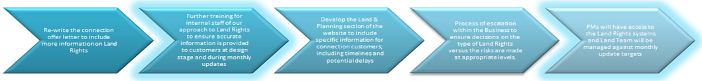
Lead Times
A recent review of the Land and Planning lead times has taken place
These are now more accurate and have been reviewed based on experience and historical data
We have communicated these to SPEN design and delivery teams in in order to aid customer communication and set
realistic expectations
These new lead times are informing online
customer guidance and literature
More information of Land and Planning
process milestones, common risks/delays
and complexities is on our website

Slide 40
A&D Fees/ Connection Offer Fees
Bev Hudson

Slide 41
A&D Fees
A reminder of why:
Not being able to charge applicants has contributed to a significant increase in connection applications.
Multiple, repeat and speculative connection requests are now commonplace, increasing costs and diverting significant DNO resources to providing offers that will never be accepted.
Whilst no direct financial impact for DNOs, there is a strong argument that the current system is unfair with costs being recovered from only those customers who accept.
Speculative applications increase circumstances of interactivity, encouraging premature offer acceptance and capacity ‘bagging’.

Slide 42
A&D Fees
Key dates:
24 March 2016 – Government publish Call for Evidence to gather stakeholder views on A&D fees (Connection Offer Expenses).
6 May 2016 – majority responses support introduction of DNOs charging before an offer is made irrespective of whether the applicant accepts.
21 September 2017 - Government publish a draft Statutory Instrument (SI) for consultation.
28 February 2018 – SI approved and laid in Parliament, Government response to consultation published.
6 April 2018 – SI will commence and apply where DNOs decide to charge A&D fees.

Slide 43
A&D Fees
Some important facts:
DNOs will be allowed to charge connection applicants A&D fees irrespective of whether they accept the subsequent connection offer.
Whilst the Regulations don’t contain specific exemptions from charging fees to certain types of applicants, DNOs have indicated they will not apply upfront fees to small LV market segments. DNOs likely to phase introduction.
Fees will be published in the DNOs’ Connection Charging Statements.
The Regulations are flexible on the timing of payment, including flexibility to charge in instalments.
DNOs will be required to inform applicants:
upon application that they may be required to pay an A&D fee; and
of relevant information about the fee, including the level of the charge, how it was calculated, payment details and the right of appeal.

Slide 44
A&D Fees
Question | Answer
What will be charged?
Budget | No
Feasibility | Yes
Quote + | No, unless progress to full quotation
Full works | Yes
POC | Yes
Requotes | Yes
Cancelled applications | Yes, after cooling off period

Slide 45
A&D Fees
Question | Answer
Will there be a cooling off period? | Yes
When will the invoice be issued? | Initially, at the same time as the quote (to be reviewed after 6 months)
When will it come into effect? | TBA
Which quotes will attract the charge? | DGHV, DGEHV and all 132kV
What charge will be required? | Currently being reviewed but will be published in Charging Statement
How will customers know of charge? | Presentations Mailshots Response on receipt of applications

Slide 46
ICE
Rachel Shorney

Slide 47

ICE Update
2017/18 ICE Report Published
Final Work Plan contained 11 Key Actions:
Customer Journey – interactive web pages
Communication External – regular Land Rights updates provided
Communication Channels – new methods utilised to engage
Website – improve navigation and content
Partnerships – develop new key relationships
Project Management – project plan templates
Land Rights – improve information in quote letter
Flexible Connections – ANM Zones publish
Telecommunications – Quotation and Delivery
– Contestable Trial
Network Planning – Information Shared

Slide 48

2017/18 ICE Plan Action 1 – Communication - Customer Journey
We said …..
We will develop an interactive tool on our website that will provide clear guidance on our customer connection process
What we have done…..
Interactive guide available on website at …
www.spenergynetworks.co.uk/
pages/interactive_guide.aspx
Customers can use this page to quickly find information, forms and contact details

Slide 49
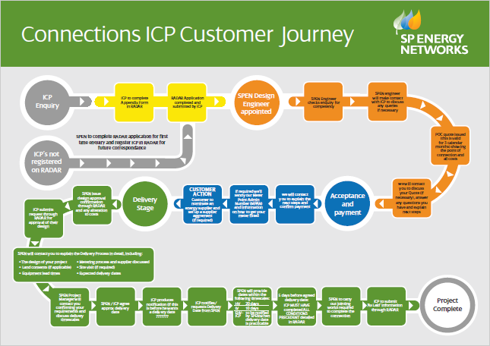
2017/18 ICE Plan Action 1 – Communication - Customer Journey
We said …..
What we have done…..
We will also provide a separate tool for our alternative connections providers (ICPs and IDNOs)
Customer Journey for ICP’s being established
Now ready to go live

Slide 50
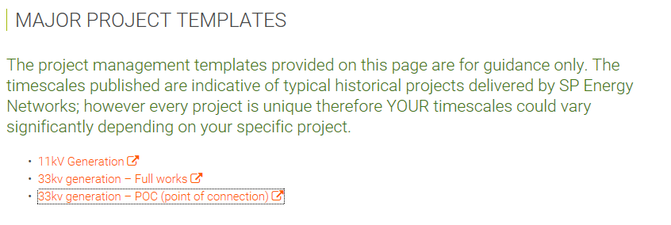
2017/18 ICE Plan Action 6 – Project Management
We said …..
We will agree at the outset of each project, key milestones and a delivery programme which reflects both the customer’s and SPEN’s project commitments.
We have published templates on our website, for typical projects, reflecting indicative timescales for each milestone.

Slide 51
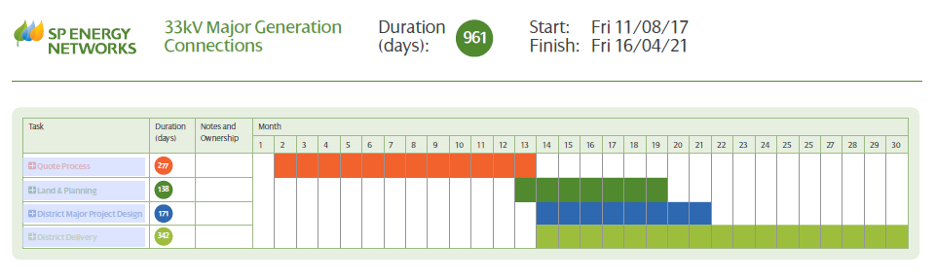

2017/18 ICE Plan Action 6 – Project Management

Slide 52
Stakeholder Events
Our commitments for engagement for 2018
2 DG Workshops
2 ICP Workshops
2 Owner/ Operator Forums
2 Developer Forums
A Stakeholder Panel meeting each quarter
Do you agree with this proposal?
We plan to issue a full calendar for 2018 by the end of this week.
52

Slide 53
Are these dates suitable for you?
April ICP Workshop – Friday 13th April – Hoylake Training Centre
May Developer Forum - Wednesday 16th May
June DG Workshop- Wednesday 13th June
Stakeholder Panel- Wednesday 27th June
July Summer Holidays
August Summer Holidays
September ICP Workshop- Wednesday 12th September
Stakeholder Panel- Wednesday 19th September
October Owner/ Operator Forum- Wednesday 17th October
Developer’s Forum- Wednesday 24th October
November DG Workshop- Wednesday 14th November
December Stakeholder Panel- Wednesday 12th December
53

Slide 54
Proposal for 2018/19 ICE Plan
1 | Communication Customer Journey Land Rights and Metering | For a number of our key connections processes, we will develop a detailed customer journey to explain and provide clear guidance for our customers. We will produce a detailed journey for obtaining Land Rights and the process for getting a meter installed, providing details of key stages and the timescales involved.
2 | Project Communication External | We will continue to monitor and assess our customer communication throughout the lifecycle of a project. We will audit against process to ensure adherence. We will introduce a new text survey which will be sent to every customer on completion of key project milestones, Quotation Issued, Project Acceptance and Project Delivery.
3 | Communication Website | We will continue to review and update the content of our website based on our stakeholder feedback. We will focus on the stakeholder area of our website and to enhance the information provided to ensure our stakeholders are aware of the depth and breath of engagement across SPEN and provide the opportunity for stakeholder participation. We will introduce a SPEN stakeholder event calendar providing details of all events. We will also improve the information on the completion of our ICE improvements by introducing a timeline of key activities linked to the relevant information
54

Slide 55
Proposal for 2018/19 ICE Plan
4 | Communication Channels | We will continue to use alternative communication channels to deliver key messages and updates. This will include channels such as online tutorials and SPEN hosted webinars. Based on Stakeholder feedback, topics will include: -DSO -A&D Design fees -Owner/Operator forums -Fault Response -Land and Planning
5 | Introduction of A&D Fees | Roll out of A& D Fees, assess the impact of roll out and look to reduce the time to provide our timescales for issuing quotations
6 | Project Management HV and LV | Following the development of project templates for our major projects. We will look to establish similar templates for smaller HV/LV projects to agree at the outset of each project, key milestones and a delivery programme which reflects both the customer’s and SPEN’s project commitments. Furthermore, we have also recognised the need for the development of the project management discipline with our delivery team and therefore will look to establish formal training for those staff deliverying our connections projects
55

Slide 56
Proposal for 2018/19 ICE Plan
7 | Partnerships Working Electric Vehicles | We will seek to establish key partnerships of stakeholders to inform our Electric Vehicle strategy and policy going forward.
8 | Partnerships Working Land & Planning | We will seek to establish key partnerships with our IDNO/ICP population to review our Land Rights process, conduct key case study learning and identify key improvements
9 | Land Rights Legal Communication | to be agreed. Essentially how do we improve the visibility of the communication that goes from lawyer to lawyer
10 | Land Rights Incorporated Process (SPM Only) | wording to be agreed. How do we ensure that process is robust and that it is communicated internally and externally
56

Slide 57
Proposal for 2018/19 ICE Plan
11 | Telecommunications Solutions Trial | Having now identified feasible projects and customers willing to participate in a trial, we will investigate the potential of making the provision of telecommunication solutions a contestable activity. Over the next year we will start to conduct trials with identified partners which will determine the feasibility and scope of future contestable telecommunications works.
12 | ICP / IDNO Interface | To assist with the uptake of the Code of Practice and our continued focus to promote its uptake, we will review our internal processes and systems to support the delivery of the code. We will establish a working group of internal/external stakeholder to undertake this review
13 | Networks of the Future | Issue tenders for network areas that have specific challenges in respect of services that could be provided by customers.
14 | Next Generation of Heat maps | Establish what the future requirements of the next generation of heatmaps should include
15 | Statement of Works | Pilot new SOW process to be rolled out to wider areas within both licence areas and explanation of the process and successes to be communicated to our key stakeholders on a regular basis and when the SOW is required for their projects. Process improvements
16 | Improved Notification Process for LCT connections | To provide a central IT database to allow customers to notify SPEN of Low Carbon Technologies connections.
57

Slide 58
Close
Andy Churchman

