Slide 1
Network Planning
Milorad Dobrijevic SPEN
Chris McKaig SSEN

Slide 2
OC2 Outage Forum
6th of September 2017
SHE Power Distribution

Slide 3
Dale Cargill
Director of Customer
Operations
Regional Manager s
David Colthart
Distribution Control Centre
Manger
01738 455894
Chris McKaig
Pauline Henehan
John Campbell
Jim Barber
Brian Morrissey
Outage and Emergency
SCADA and Commissioning
System Performance Manger
Operational Support
Operations Manager
Planning Manager
Manger
01738 512387
Manager
07767852434
07876837186
01738 453370
01738 455852
Distribution Control
Trainee
Deirdre MacDuff
Technical Support
System Performance
Distribution Control
Distribution Control
Engineer
Distribution Control
Outage Planning
Assistant
Engineer
Engineer
Shift Leader
(
Days
Engineer
)
Engineer
(
Shift
)
Distribution Control
Trainee
01738 457546
Technical Support
System Performance
Distribution Control
Distribution Control
Engineer
Distribution Control
Assistant
Engineer
Engineer
Shift Leader
(
Days
Engineer
Laura Sneddon
)
Outage Planning
(
Shift
)
Distribution Control
Trainee Control Engineers
Engineer
Technical Support
System Performance
Distribution Control
Distribution Control
Engineer
01738 457882
Assistant
Engineer
Engineer
Shift Leader
(
Days
)
(
Shift
)
Distribution Control
Technical Support
System Performance
Distribution Control
Distribution Control
Engineer
Assistant
Engineer
Shift Leader
(
Days
)
(
Shift
)
Distribution Control
Technical Support
Distribution Control
Distribution Control
Engineer
Assistant
Engineer
Shift Leader
(
Days
)
(
Shift
)
Distribution Control
Technical Support
Distribution Control
Distribution Control
Engineer
Assistant
Engineer
Shift Leader
(
Days
)
(
Shift
)
Control Engineers
Outage Planning
Commissioning Team
Distribution Control
Shift Leaders
Engineers
Engineer
(
Shift
)
Control Engineers

Slide 4
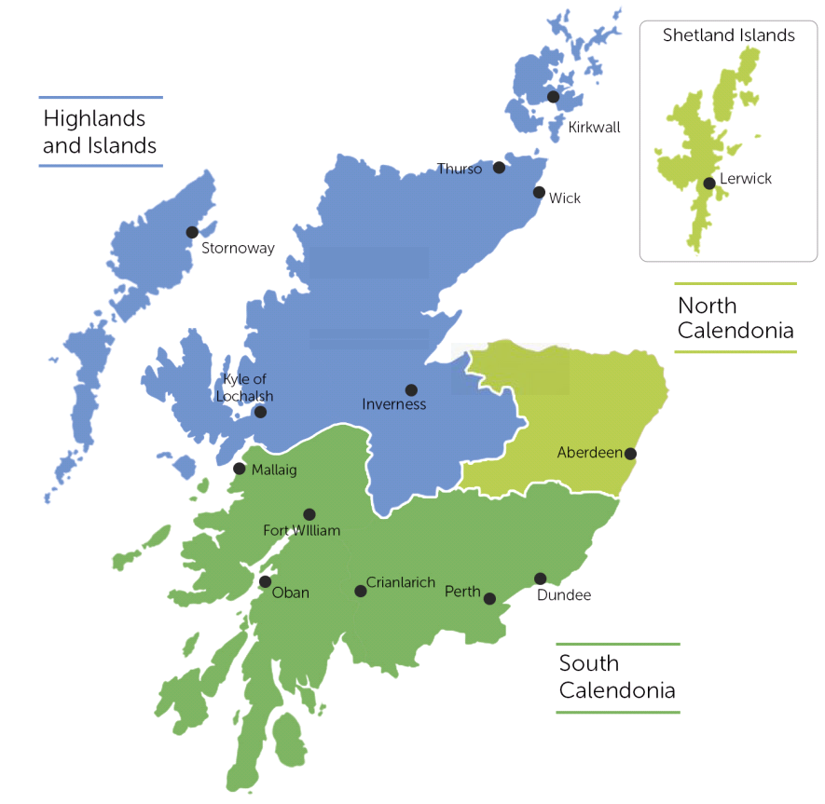
Customer Relationship Managers
  South Caledonia – David Morrissey 07767852093
  Highlands & Islands – Pamela Harvey 07469 411432
  North Caledonia – Shona Horn 07500912566

Slide 5

Stakeholder Engagement
Planned Stakeholder Engagement Forum
Stakeholder Advisory Panel
Attendance at BHA Annual Conference
Clear Concise communication of Constraint Requirements
Investment in a new online Portal for stakeholder information

Slide 6
Proposed New Connections
South Caledonia
  Abernethy
  Burghmuir
  Ceannacroc
  Charelston
  Coupar Angus
  Dunoon
  Fort William
  Killin
  Kinlochleven
  Lunahead
  Milton of Craigie
  Rannoch
  Strathleven
  Taynuilt
  Tummel Bridge
North East
Strichen
  Keith
  Elgin
  Kintore
  Dyce
North Caledonia
  Boat of Garten
  Fort Augustus
  Grudie Bridge
  Inverness

Slide 7
Proposed Network Refurbishment
Circuit Breaker Replacements
Carnoch Regulator
Lochaline Primary
Woodhill Grid
Willowdale Grid
Whitehouse Primary
Mill Rd Primary
Wick Primary
Balnagask Primary
Ruthrieston Primary
Craigiebuckler Primary
Inverbervie Primary
Transformer Replacements
Balnagask Primary
Friockheim Primary
Mallaig Primary
Bridge Of Don Primary
Charles Avenue Primary
Craigiebuckler Primary
Mill Rd Primary
Newtonhill Primary
Subsea Cable Replacements
Yell to Unst
Rousay to Westray

Slide 8
New Technology
Red Zone Harvester
SSEN’s Red Zone tree harvester allows trees to be cut in direct proximity to overhead lines whilst the line is live.
This reduces the requirement for outages and constraints.
Dynamic Positioning Ships
Dynamic positioning is a new technology we are looking to adopt for the replacement and installation of subsea cable.
Boats stay on course, regardless of tide or weather conditions greatly minimising outage duration and outage date changes

Slide 9
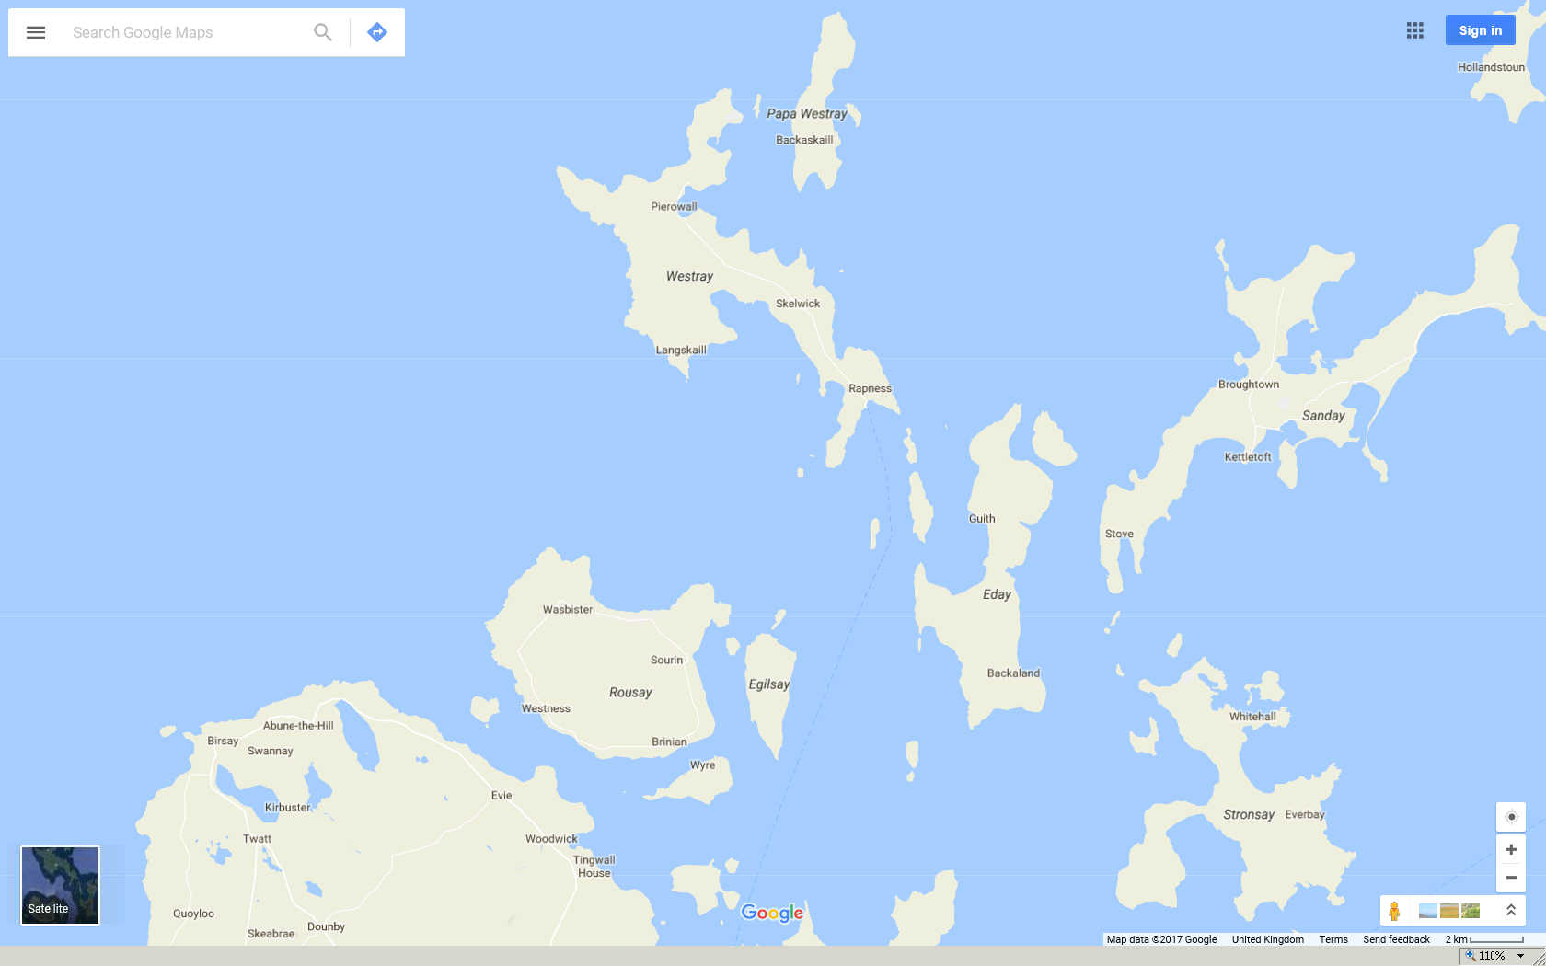
Rousay to Westray

Slide 10
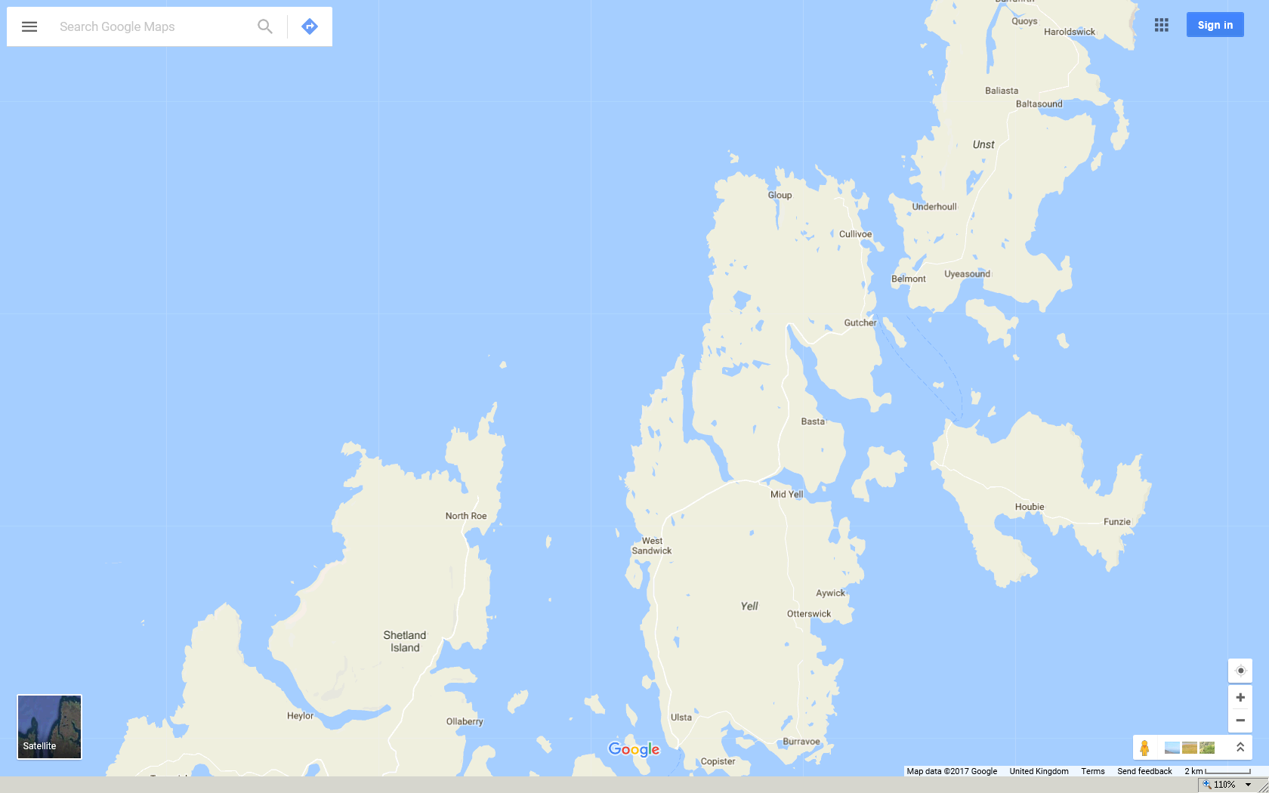
Yell to Unst
10

Slide 11
SHE Power Distribution - Reductions in Constraints
  Investment in new technology
  Optimisation of refurbishment works
  Optimisation of the distribution and transmission year ahead reporting timelines

Slide 12
Any questions?

Slide 13
AGENDA
Occ Planning department structure
Outage Planning process
Transmission
Distribution
Constraints
Show and Tell

Slide 14
DEPARTMENT STRUCTURE
OUTAGE PLANNING DEPARTMENT
LONG TERM PLANNING
T&D
MEDIUM TERM PLANNING
T&D
SHORT TERM PLANNING
T&D
CONTIGENCY PLANNING & RISK MANAGEMENT
CUSTOMER & STAKEHOLDER ENGAGEMENT

Slide 15
Long Term Planning Role
Year 8 – Year 1
Medium Term Planning Role
week 52 – week 5
Short Term Planning Role
week 4 - day ahead
Create and manage high level individual Year 8 – Year 3 draft outage proposal
Create and manage a detailed set of outage proposals for planning years 2 & 1
Attend the various long term interface meeting with NGET & SSE
Manage the internal long term interface meeting working with “T” Major Projects, the distribution development house, IEC & all other relevant stakeholders
Develop a communication mechanism with relevant external stakeholders e.g. generators , “T” connected customers, etc
Transmission & Distribution System Review Group
OCC interface into the System Construction Agreement process
Mange the year ahead plan handover from the long term planning engineer
Constantly manage the year 0 plan ensuring the plan is followed as closely as possible
Work with major projects to ensure project teams are ready for their outage windows
Carry out relevant network studies to identify key network risks \ issues
Contingency planning – work with projects \ Tops \ Districts to ensure contingency plans are in place key outages
GSP check lists management
Scheme reps for major projects
STCP 19.4 requirements & interface with SCADA section
Prepare & Issue generation constraints
Major T & D customer interface
Control Room day \ evening \ weekend shifts
Create \ manage day ahead outage plan
Create \ manage week ahead outage plan
Create \ manage 4 week to week ahead outage plan
Manage OPD outage bookings for any planned outage changes \ short notice outage requests \faults
Weekly maintenance meeting
Update reports \ trackers \ scorecards
Communication with Districts \ TOPs \ Major projects \ NGET \ generators re outage updates, risks & contingencies
Scheme reps for major projects
Update generation constraints

Slide 16
OUTAGE PLANNING PROCESS - TRANSMISSION
Follow the system operator – Transmission owner codes of practise (STCP’s)
2. Other connected parties follow the grid code – section OC2
3. Transmission owners / generators / distribution network operators / “T” connected customers all submit outage proposals to system (so) at year ahead stage, system operator creates the outage plan.
4. Year ahead outage plan is required to be security and quality of supply standards (SQSS) compliant.
5. Within the year – Follow the plan………

Slide 17
Outage Planning Process – Year 2018 / 19
Over 52 different projects included in the plan for the next outage planning year (55 in the current year)
Approximately 490 outages aligned with major project outages wherever possible
Maintenance outages aligned with major project outages wherever possible
Ongoing network construction & windfarm connection continuing in SW Scotland
Massive capital program continuing to modernise and reinforce the Scottish Transmission networks.
Now at the half-way point in RIIO-T1

Slide 18
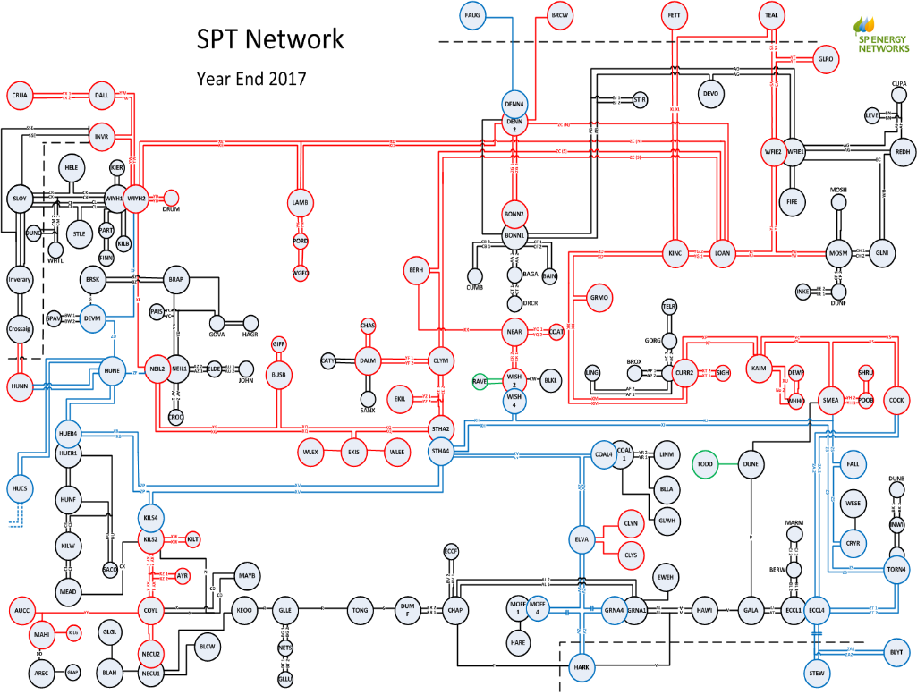

Slide 19
Outage Planning Process - Distribution
Distribution network becoming more “active” requirement to enhance the outage planning process
Transmission outage planning principle to be implemented into Distribution
Long term & within year outage planning process being implemented
    Long term – year 1 to year 6
    Within year – fixed quarterly outage plan
4. Improved customer & stakeholder engagement required
5. £4.5 billion capital program until 2023 to modernise & reinforce SPD’s Distribution networks North & South
6. Numerous Projects & new connections planned for 2018 covering
- GSP Switch board changes
- Primary switch board changes
- Transformer changes
- OHL & cable routes
- Fault level mitigation
- New connections

Slide 20
Network Constraints & Constraint Management
Network constraints – circuits that have insufficient capacity to carry all the power required at certain times e.g. post faults, but constraints can also be caused by
- Voltage
- System stability
2. Constraints are generally managed by decreasing or increasing generation output
3. Distribution generators maybe affected by constraints on the “D” network, the “T” network or in some cased both networks
4. Depending on the generators connection agreement they maybe part of the
- National balancing system incentive scheme (BSIS)
- A load management scheme
- Active network management scheme
Note – even an intact system can be exposed to constraints

Slide 21

Examples

Slide 22
