Slide 1
Queue Management
Paul McGimpsey SPEN
Gary Bartlet SSEN

Slide 2
Agenda
What is the issue?
Current development – What is going on in industry to it?
Governing principles
SPEN consultation outcomes
Progession milestones
Principles of Queue Management
Treatment of Stalled Projects
Queue Management – In Practice
Work underway and next steps

Slide 3
Application
Pre Queue (ENA Consultation – Treatment of changes to Connection Application
Contract management
ENA Consultation – Progression Milestones
Queue Management
SPEN Queue Management – Policy published Dec 2016
Connected Sites
Capacity Management
Other Options
Flexible connections
Capacity Sharing
Behind the meter’ ANM

Slide 4
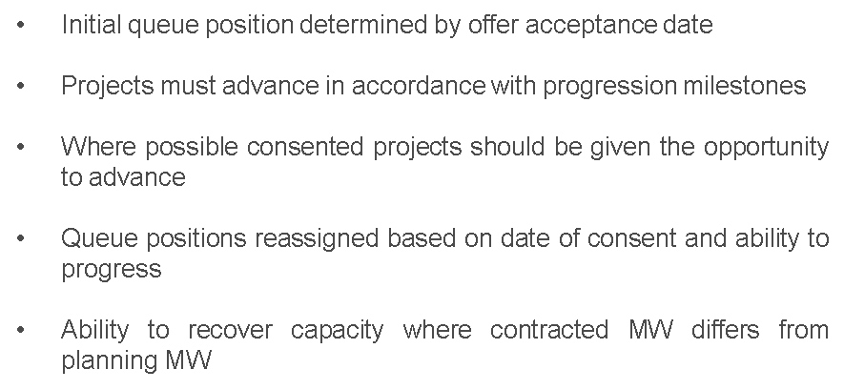

Slide 5
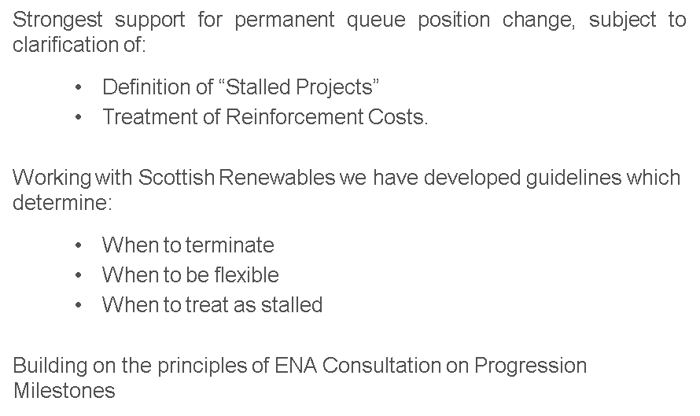

Slide 6
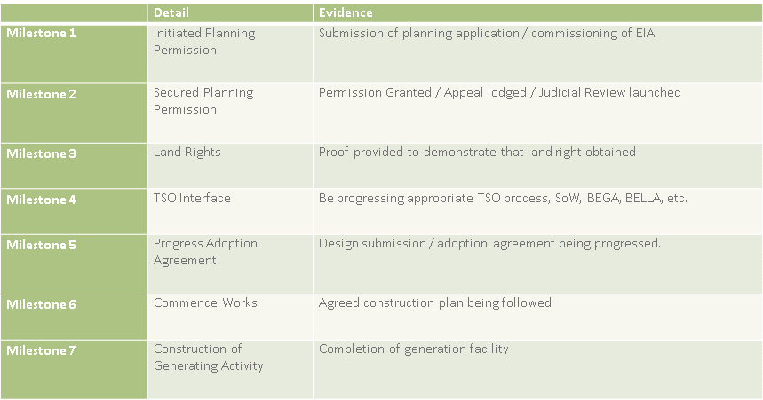

Slide 7
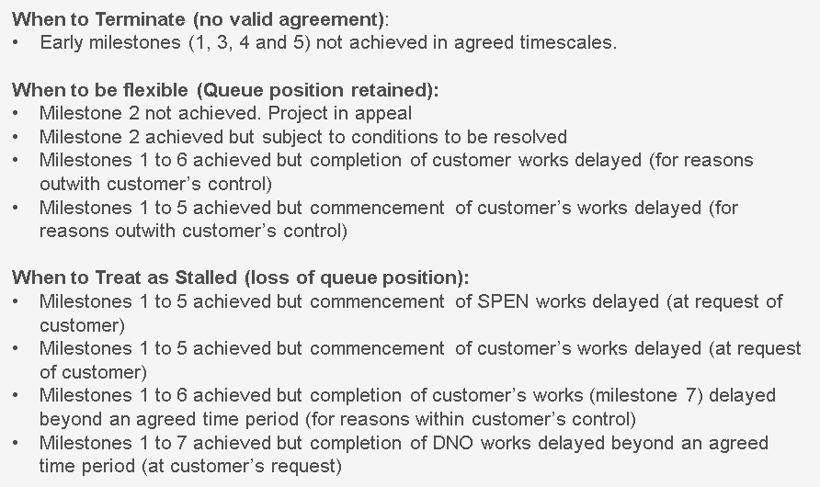

Slide 8
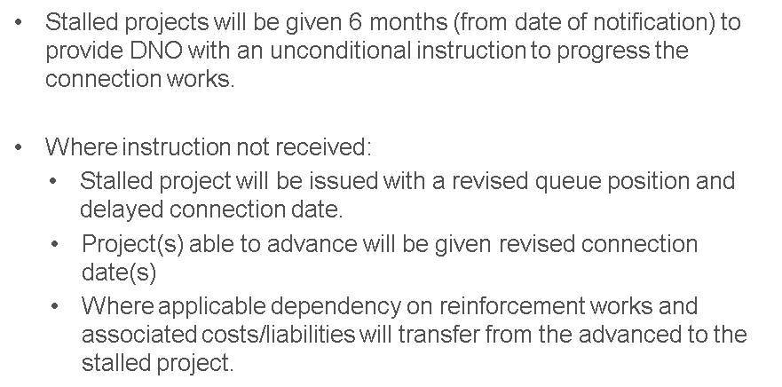

Slide 9
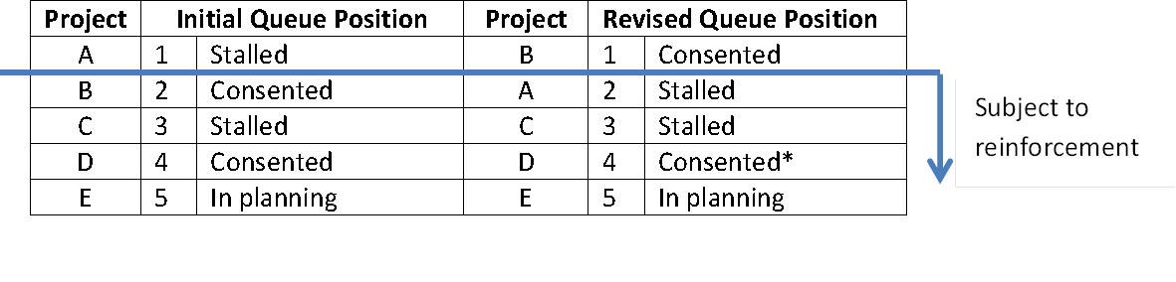

Slide 10
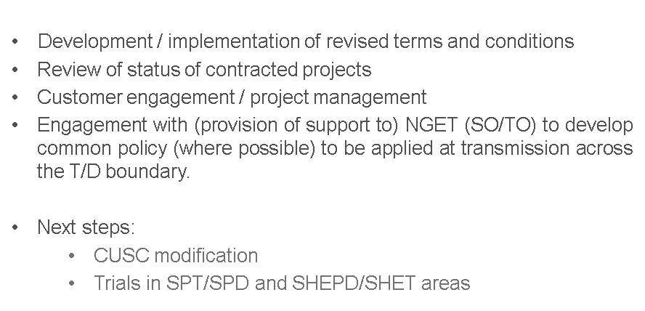

Slide 11
Queue Management – Conclusion
There will be winners and losers in applying Queue Management
Work is underway to identify “stalled projects” and identify opportunities
Limited powers to reclaim under-utilised capacity from connected sites but potential benefits of releasing
Re-introduction of Assessment & Design fees will free up design resource for wider roll-out
Help us to help you!

