Slide 1
Statement of Works (SoW)
Deborah McPherson SPEN
Euan Norrington SSEN

Slide 2
ENA SoW Working Group Established – Summer 2015
SoW improvement proposals developed and presented to DG For a 2015
Engagement with NGET to develop principles of Scottish Trials using SPEN proposals
Engagement with NGET, UKPN, SSEN & WPD to establish Regional Development Plans
Trials with SPEN (SPD) and UKPN commence 2016
Working Group absorbed into the Open Networks Project, Workstream 1
Product 7 Work Group Established – DNO Transmission Impact Assessment (TIA)
Work to Date
NGET SO will develop planning limits that will be available to DNOs
New contract schedule will provide visibility of contracted DG for each GSP
New process will be established for regular information exchange
What does this mean for DNOs?
What does this mean for Customers?
DNO can make DG offer without individual application to NGET in many cases
This gives DG more and better information earlier in the process – greater certainty

Slide 3
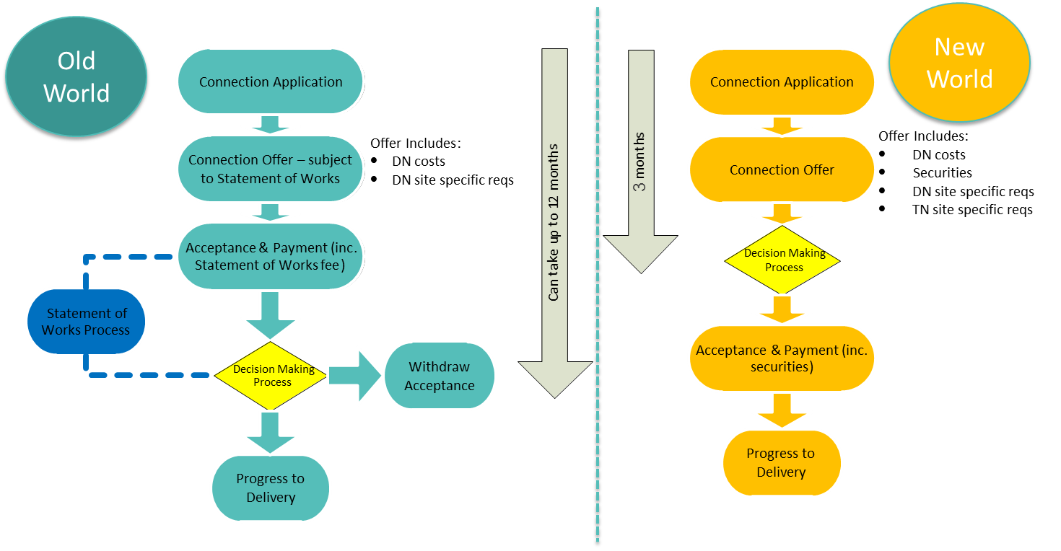
Increased certainty and control
Reduced timescales and costs
Removal of invoicing issues
Increased visibility of DG to NGET
T impact included with DNO Offer

Slide 4
To provide customers with an improved, more efficient, timely and cost reflective process; and consistent across DNOs.
To enable DNOs to provide customers with visibility of the known transmission impact within distribution offers made to their customers within licence/GS timescales. Where applicable, this will include detail of any operational restrictions and requirements, transmission works required, costs, security and liability and impact on timescales to connect.
To provide customers with an offer which can be assessed fully in order to make the necessary investment decision.
To establish planning limits with DNOs
Better Queue Management
1
2
3
4
5
To enable DNOs to provide customers with visibility of the known transmission impact within distribution offers made to their customers within licence/GS timescales. Where applicable, this will include detail of any operational restrictions and requirements, transmission works required, costs, security and liability and impact on timescales to connect.
To provide customers with an offer which can be assessed fully in order to make the necessary investment decision.
To provide customers with an improved, more efficient, timely and cost reflective process; and consistent across DNOs.
To establish planning limits with DNOs
Better Queue Management

Slide 5
SP Distribution
New proposed process trialled across 4 GSPs
SPD offers made detailing known transmission system works, associated charges/securities along with the completion date
Visibility and understanding of the planning limit and known transmission constraints has provided SPD with the ability to make a complete offer product minimising the need for referral to the SO
Timescales to provide transmission impact reduced significantly from that experienced by DG under existing SoW process as all information has been included within the SPD offer – Pre Trial up to 12months post DNO offer, during Trial in line with DNO Offer timescales
Reduced capacity reservation from accepted offers awaiting clarification of the transmission impact via the existing SoW Modification Application process (no offers have to date been accepted under the trial)

Slide 6
UK Power Networks
Appendix Gs initially trialled across 7 GSPs (Grid Supply Points) in SPN region
23 scheme acceptances without need for SoW
445MW offered against headroom of 252MW through managing attrition
Appendix Gs continue to be issued across SPN and EPN
More flexibility where transferable capacity is available
Only really works well in areas with low levels of DER activity
WPD
Appendix G trialled progressively across all GSPs in all 4 Licence areas since May 2016
Customers have been provided with feedback on transmission impact quicker
Has in some cases provided informal feedback pre-offer, where there are significant hurdles on the transmission network
Most GSP Appendix G’s had an initial Materiality Headroom of 50MW, although a few had much lower headroom
The Monthly updates of Appendix G have resulted in an increase/decrease to the materiality headroom

Slide 7
DNO Statement of Works (SoW) Product Transmission Impact Assessment (TIA) Establishing Planning Limits - Programme
Workstream Members have agreed that a project based approach to establish DNO Planning, linked in with NGET Regional Development Plans, will best benefit customers and achieve the overall objective of Product 7.
In order to undertake a GB wide assessment, work has taken place to:
Develop approach to establish planning limits
Identify areas of priority for roll out
Develop timescales for rollout
Identify resource requirements
Consider funding implications
Benefits of approach will
Ensure that all DNOs/TOs/SO are committed to the programme and deliverables
Provide customer visibility of programme roll-out
Ensure consistent treatment of custom

Slide 8
DNO | Network Area | Existing Trial/Planned Trial
WPD | WPD/NGET to confirm | Existing
SPD | Linmill, Cupar, Dunbar, Berwick Dumfries & Galloway (11 GSPs) | Existing Planned
UKPN | UKPN/NGET to confirm | Existing
SSEN | SSEN/SHET to confirm | Planned

